Slide 1
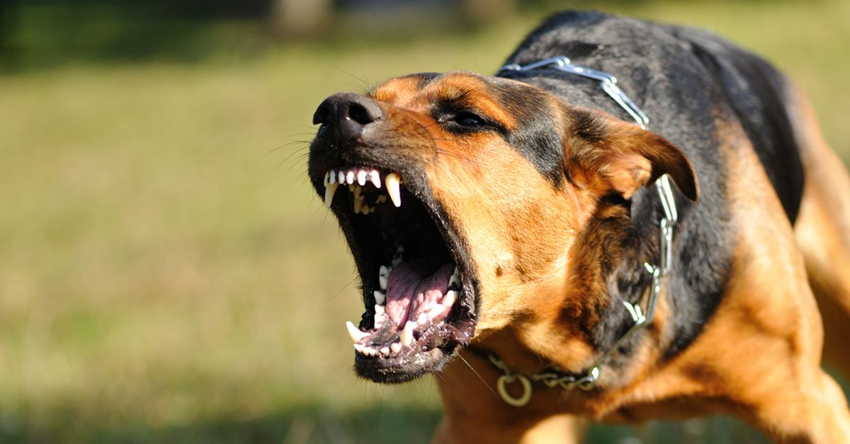
Dog bites injuries to man IVA 3
This presentation is supported by VFU IVA project no. 2019FVHE/2380/63
https://www.oconnorpersonalinjury.com/dog-bite-lawyer/

Slide 2
The content of presentation
The dog attacks on man
The EU countries restricting dog breeding
The forensic odontology
The incidence of injuries in the Czech Republic
The prevention of dog attacks on humans

Slide 3
The dog attacks on man
They represent a serious problem, including not only an acute risk of damage to health, but also permanent consequences or endangering life
Victims of attacks are usually not aware of what caused the attack
Dog injuries account for the largest proportion of all human injuries caused by an animal
Even a friendly dog ​​can bite when it is struck, irritated or is confronted without proper control with a situation that triggers its natural social behavior
Aggressive behavior is part of the natural behavior of socially living animals
Violent behavior is preceded by the emergence of the emotion that triggers the attack itself
Aggression in dogs can be the cause of a number of serious injuries caused by a dog.

Slide 4
The dog attacks on man
Dog incidence rate: 1.5 % per year in all age groups
Hypothesis: Not all dog attacks are reported
Low human mortality after dog attack (1 in 5 million per year)
70 % of deaths following a dog attack occur in children under 11 years of age and adults over 69 years of age
Higher risk of attacking children than adults (2-5 times greater risk)
Children are most often bitten on the neck and head, adults on the limbs

Slide 5
The dog attacks on man
Men are more bitten than women
In children most boys, 5-9 years
Nahlik et al. (2010) study of children attacked by a dog: in most cases, they were attacked after dog challenge, dog abuse, irritation and physical harm to the animal
Most reported cases from large dogs, while the most serious consequences of the attack are from large dogs
Most cases: NO, RTW, bull breeds, husky, small dachshund, Chihuahua, Jack Russell Terrier
Male dogs attack more often than females, more often uncastrated

Slide 6
Types of behavior in a dog that often lead to injury or bite by the dog:
Dominant: The dog competes for the superior position, for the corresponding position of the member in the group (pack).
This form of aggression in the dog includes defending things, food, toys.
A normal dog considers a human in a sense as a member of "its kind" and adapts its behavior accordingly.
It is crucial and necessary that the dog perceives his own man as a superior individual (leader).
If this is not the case, in many cases the risk of socially motivated aggression increases.
Defensive: The dog seeks territorial defense of a certain area or place from foreign dogs or people (defense of a member of their own pack, pups).
The dog feels pain, fear or illness.
Relatively frequent cause of defensive aggressive reaction of the dog is called biting for fear.
A fearful aggressor threatens and bites in an attempt to keep a “supposed or real enemy” at a safe distance (in an attempt to intimidate him or discourage him from intending to contact him).

Slide 7
Behavior of a dog that is incorrectly associated with the development of aggression in a dog:
Hunting: Behavior that is conditional on intraspecific survival, obtaining territorial, social or other benefits within its own species can be considered as real aggression.
The reason why a dog chasing a hare is not aggression, but a hunting instinct.
The aim of the hunter is not to acquire territory or a higher social status (eg. for mating and breeding offspring).
The predator must obtain food to survive. Part of the hunting behavior of the dog is an instinctive reaction to the moving object, lurking, chase, catching prey.
The hunting behavior of an untrained dog can not be considered, for example, the pursuit of a cyclist (or a child who runs away from the dog and screams, etc.).
Dog attack in this case is preceded by "disturbance" of safe distance and "escape of the intruder" (cyclist, child, etc. will approach the dog, then move away), it is an attack dog from the social behavior.
To guide and control hunting instinct in the dog leads his training and education.

Slide 8
Video about dog attacks
https://www.youtube.com/watch?v=z-hqv1UC8Q8

Slide 9
The prohibition of breeding selected breeds in EU countries
UK: ban on breeding and arrival with breeds - American Pit Bull Terrier, Dogo Argentine, Brazilian Fila, Tosa Inu
Poland: since 1998 determines criteria for breeding pit bulls
Germany: strict breeding conditions for 10 breeds
Denmark: prohibition of breeding and displaying 11 breeds
Ukraine: 80 breeds in the list of particularly dangerous breeds
Russia: list of dangerous breeds, Animal Welfare Act
In the Czech Republic breeding of dogs is not legally limited or otherwise regulated.

Slide 10
Forensic odontology: Dog bite analysis
Forensic odonto-dentistry studies bite wounds
Bite wounds are specific, as are fingerprints
Each animal has different teeth
Interspecific differences
Influence on bite wound appearance: anatomical bite area, position, age of victim
It is not always apparent that this is a minor injury
Typical of dog bites: punctures from canines, lacerate and avulsions leading to irregularities in the wound edges, sometimes associated with scratches from the claws around the wound

Slide 11
Forensic odontology in practice
Dental imprints have the character of animal species, breed, specifics of dental treatments and measurable data
Width and shape of the arc, gaps between individual teeth
Shape, number and size of individual teeth
Tooth marks vary from scratches to deep lacerations
Human prints: mostly circular or oval, highly individual!
Cats and psi-asymmetric jaw arches, mandibular arch narrower and shorter (except brachycephalic breeds)
Cats 30 permanent teeth, dogs 42

Slide 12
Forensic odontology in practice
The shape and size of the dog's tooth print depends on the breed and the size of the dog
Less variable prints on different cat breeds
Large breed differences make it difficult to identify the species
It is important to be able to identify potential bites - they may appear as crushed tissue (stools), tissue avulsions, claw scratches, fractures

Slide 13
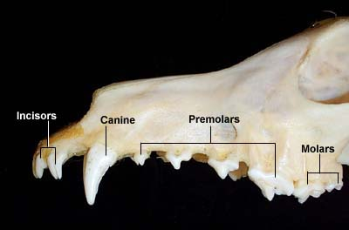
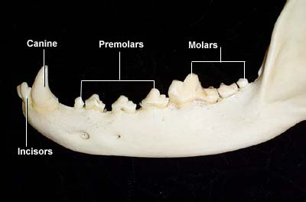
Dog teeth
Copyright © Forensic Vet Ltd

Slide 14
Cat and dog teeth charts
Wiring Diagram Database

Slide 15
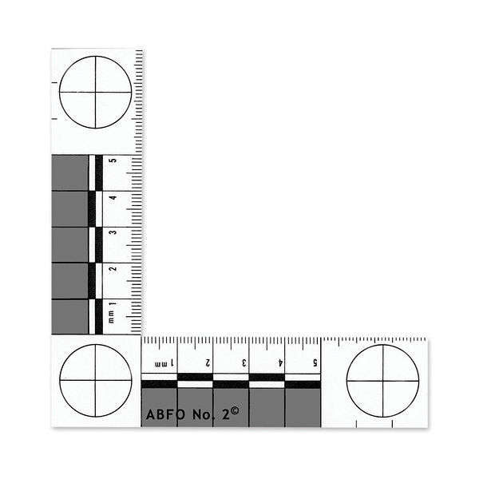
Scale ABFO
www.safariland.com

Slide 16
Forensic odontology video
https://www.youtube.com/watch?v=4Ed57ZCoXjg
Forensic veterinary medicine: investigation
https://www.youtube.com/watch?v=H09Ahp_1b8Q

Slide 17
Bite and punch dog in the Czech Republic
All injuries requiring professional medical assistance are registered by the human physicians in the injury database and assigned the appropriate code according to their classification in the International Statistical Classification of Diseases and Associated Health Problems.
According to the International Statistical Classification of Diseases and Associated Health Problems, code W54 is Dog Bite or Strike.
These data are recorded in the database of the Institute of Health Information and Statistics in the Czech Republic (IHIS).
The Institute of Health Information and Statistics in the Czech Republic records concerning bites and strokes of dogs, namely the number of treated, the number of hospitalized and the number of deaths due to bites and strokes of the dog. It also records data on the age category of the injured, the sex of the injured, the place of injury and the place of the incident. These data refer only to the injured and there are no data on dogs that caused the injury.

Slide 18
Dog bites and blows are identified as potential sources of potentially serious human disease (Ozanne-Smith J, 2001).
The most serious injuries caused by bites or strokes by a dog include open wounds, inflammations of the subcutis, fractures leading to temporary or permanent health constraints, mental trauma and premature death (Rajshekar, 2017).

Slide 19
Incidence of dog bites or strikes in the Czech Republic (2010-2018)
 | Outpatient treatment | Hospitalization of the patient | Patient's death
2010 | 111 012 | 4030 | 1
2011 | 112 176 | 3798 | 1
2012 | 118 572 | 3682 | 1
2013 | 121 074 | 4102 | 1
2014 | 124 660 | 4367 | 1
2015 | 128 905 | 4088 | 1
2016 | 133 629 | 3194 | 1
2017 | 136 751 | 3665 | 1
2018 | 112 523 | 3210 | 0
Total | 1 099 302 | 34 136 | 8

Slide 20
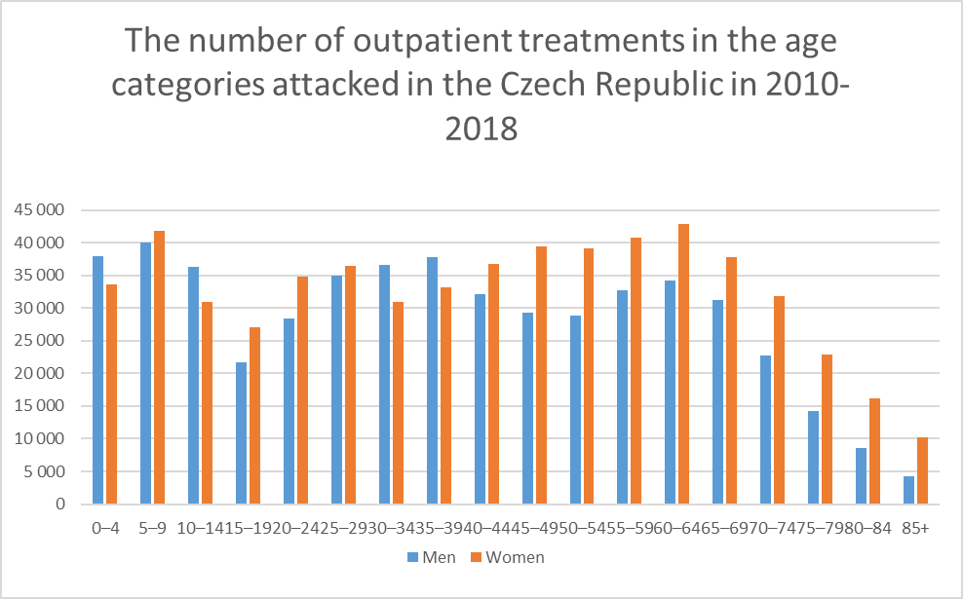
Age and gender

Slide 21
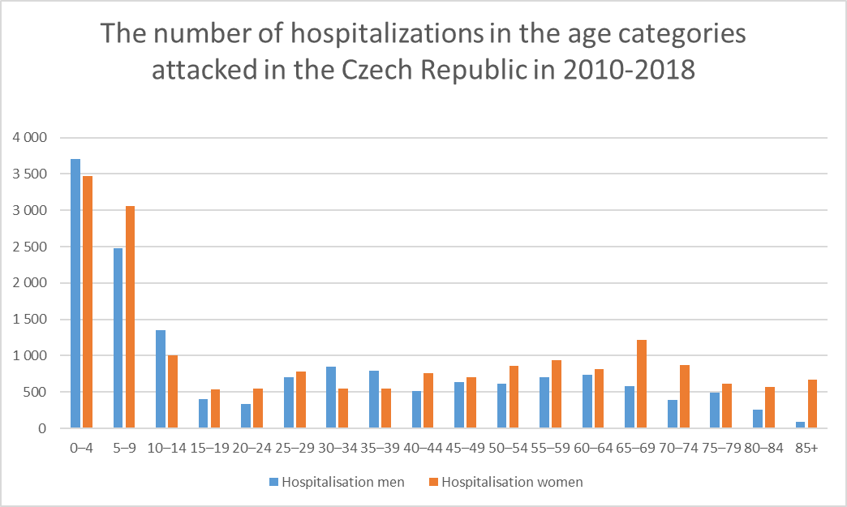

Slide 22
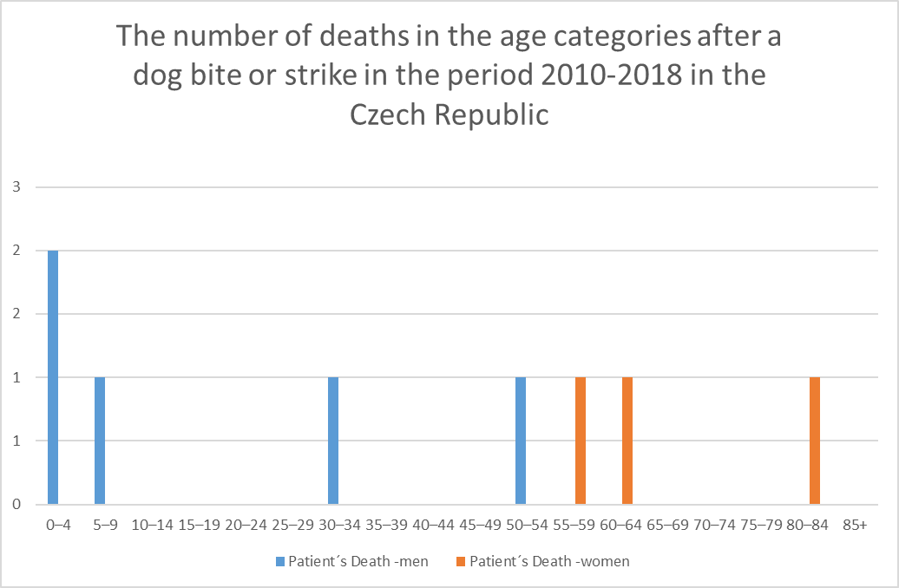

Slide 23
The most common area of ​​injury after a dog bite or impact
 | Outpatient treatment | Hospitalization of the patient | Patient´s death
Head | 130 019 | 14 563 | 2
Neck | 3 175 | 234 | 2
Chest | 8 179 | 437 | 0
Abdomen, lumbar part of back, pelvic injury | 12 749 | 894 | 0
Shoulders and arms | 24 287 | 918 | 0
Elbow and forearm | 115 632 | 3381 | 0
Wrist and hand | 308 417 | 4747 | 0
Hip and Thigh | 40 422 | 1594 | 0
Knee and shin | 97 850 | 3216 | 0
Ankle and foot | 19 902 | 382 | 0

Slide 24
Dog attacks by region in 2010-2018

Slide 25
Dog attacks by region in 2010-2018

Slide 26
Dog attacks by region in 2010-2018

Slide 27
The place of attack
The place of attack | Outpatience treatment | Hospitalization of patience | Patience´s death
Home | 578 209 | 18 024 | 1
Other specific places | 128 347 | 4 213 | 0
Non- specific places | 230 370 | 6 305 | 6
residential institution | 40 603 | 1 258 | 0
Premises of trade and services | 7 466 | 130 | 0
Industrial and construction premises | 2 308 | 52 | 0
Sports and athletic facilities | 4 495 | 195 | 0
Schools, other institutions and public administration spaces | 3 932 | 129 | 1
Roads and streets | 93 306 | 3 674 | 0
Agriculture | 10 266 | 156 | 0
Total | 1 099 302 | 34 136 | 8

Slide 28
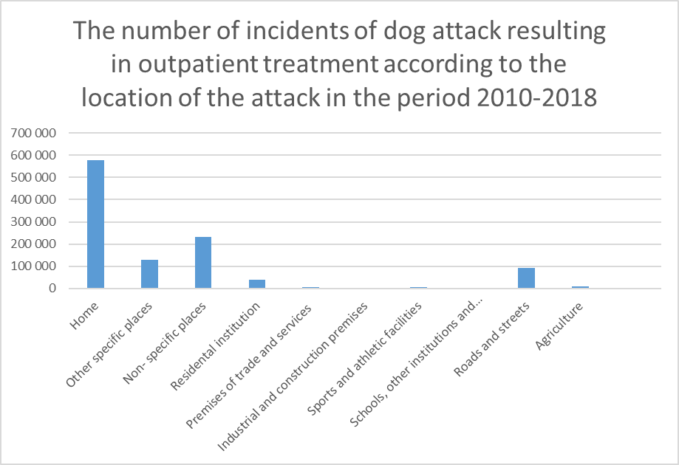
The place of incident

Slide 29
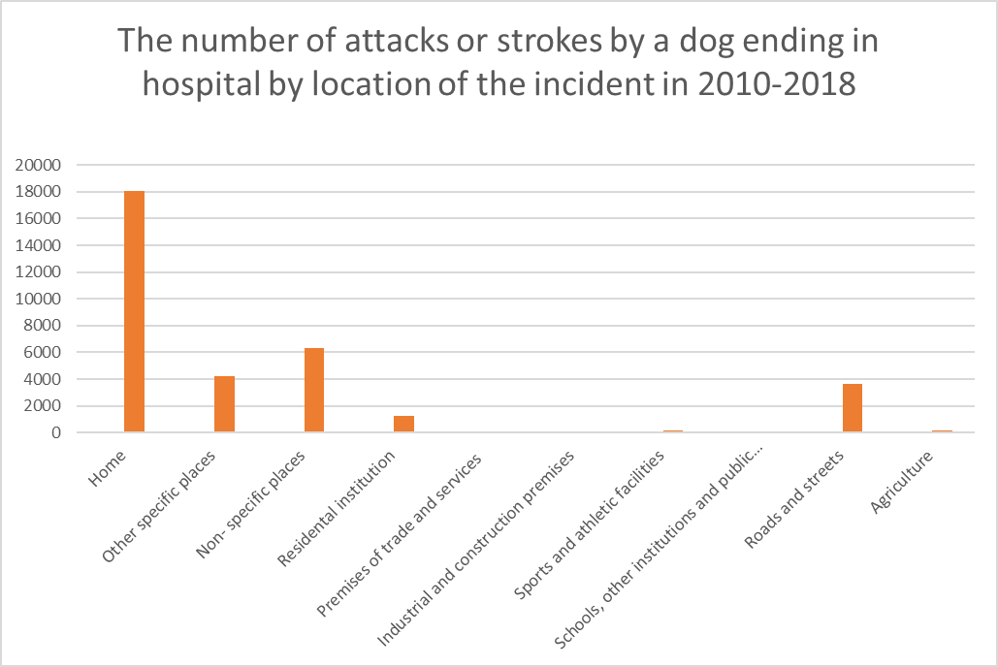
The place of the incident

Slide 30
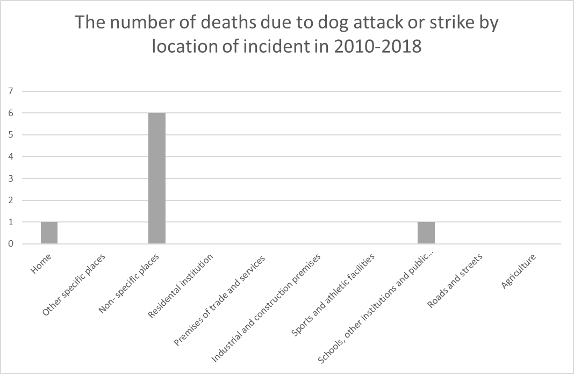
The place of the incident

Slide 31
Summary of data results
Statistical data show that in the monitored period 2010-2018, in total 1,099,302 patients were treated in the Czech Republic out patiently, on average 122,145 persons per year.
In the period under review, a total of 34 136 patients were hospitalized, an average of 3793 per year. Since 2010, 8 deaths due to bites and strokes have been recorded.
Children under the age of 10 living in the same household with a dog appear to be the most risky group of people for biting and striking a dog (Messam et al., 2018). Boys and younger children are more at risk of dog bite and blow than girls and older children (Messam et al., 2018).
Most injuries occur according to the data in the home environment, then in an unspecified place, and also a significant percentage of cases takes place in the public (street).

Slide 32
Summary of data results
Most cases of outpatient treatment are registered in the Central Bohemia Region, as well as hospitalization in the period under review.
On the contrary, the least outpatient treatment occurs in the Liberec region, the least hospitalization of the patient due to W54 in the Karlovy Vary region.
Out of 1,099,302 outpatient treatments, most injuries were due to hand and wrist injuries (308,417), head injuries (130,019), and elbow and forearm injuries (115,632). Patient hospitalization required the most cases of head injuries (14,563), wrists and hands (4747) and elbow and forearm injuries (3,381) out of a total of 34,136 injuries ending hospitalization in all regions in the reporting period.
An average of 122 145 people are treated on an outpatient basis every year, another 3793 people are hospitalized for dog bites and blows. Last year, the number of injured, hospitalized and deceased patients decreased significantly. Preventing bites or strikes by a dog lies in educating people, especially parents of small children, who appear to be the most risky group.

Slide 33
Another part of the prevention is compliance with the Decree, which sets the rules for the free movement of dogs in the municipality, which is individual in each municipality and determines the criteria for the free movement of dogs in public areas (with muzzle, leash, muzzle and leash).
In the Czech Republic breeding of dogs is not legally limited or otherwise regulated.

Slide 34
Prevention of dog bite
How to behave in danger of a dog - or its attack:
1. Try to keep calm.
2. Consider your situation and try to find an appropriate solution from the dog's response and attitude.
3. Avoid rapid and sudden movement. Any violent movement (arms, hands, etc.) can trigger a dog's attack. Stand still and leave your hands along your body. Do not try to save the dog escape!
4. Do not stare, dog stiff in the eyes. Dogs focus their prey on sight and direct sight can initiate the attack of the dog (the dog is considered to be the prey itself and from such a situation only two possibilities for him: escape or attack).
5. Despite your current state of mind and situation, try to speak to the dog in a soothing, calm voice. Intonation of your voice is important, not the content of words. "Look" at the dog as if unintentionally, side unfixed gaze and watch his reactions.
6. Try to slowly back away from the dog, keep talking in a soothing voice (such as a good dog, etc.). If it comes to you, let yourself be smelled. Let the dog go. Wait and slowly, back away from the dog.
7. If you fail to avert the dog's attack, try to face his attack according to your abilities and possibilities.
8. Be aware that in fact very few dogs are trained to clash with humans (service dogs). Most dogs that threaten humans in public are dogs between "attack and escape".
9. If you cannot or cannot stand the dog, try to turn it sideways and back. Crouch down and bend your back, pressing your hands against your body, keeping them in your lap. Frontal attack is easier for the dog, because it can attack the limbs, neck, chin, shoulder, etc. Conversely, the opposite position (curled body) reduces the likelihood or intensity of the attack and the severity of injury.
10. If a dog attacks you or knocks you to the ground, curl up, protect your arms with your arms (elbows pointing to your knees, clasped palms protecting the top of your head, wrists protecting your ears). Don't move, stay calm. Wait for the dog to leave. Do not underestimate the distance between you and the dog before you decide to get up. When standing up watch closely the reaction of the dog, if it is still in sight and if you are interested, rather get up.

Slide 35
Prevention of dog bite
Your more active approach in a risky situation can completely clash with a dog.
But it is always necessary to carefully evaluate the situation, consider your options, means of defense and the chance of success.
1. Try to expel the dog from your vicinity in a determined, firm voice, such as “Go home. Go away".
2. If the dog remains near you and shows no signs of departure, step up your threat (louder, deeper cry).
3. Look the dog directly in the eyes and step towards him. Some dogs discourage your resolve from attacking.
4. If the dog does not run and if it will try to orbit you, turn towards it.
5. Slowly move back from the dog.
Learn the meaning of the "body" language of dogs. From the overall behavior, attitude or a wide range of other means of expression of the dog you get an idea of ​​its immediate intention.
Friendly tail wagging is different from a “tail wag” dog that is not friendly to you.
Be careful and behave to minimize the risk of biting your dog.
Do not forget the stimuli and situations that may trigger the instinctive behavior of the dog, as well as situations that prevent such behavior of the dog.
Do not contribute to your risk situation by your behavior. On the other hand, learn to prevent risky situations. Keep in mind that most injuries can be prevented by proper behavior.

Slide 36
Children and dogs
Never leave a child with a dog alone and do not allow a child to play games with a dog that stimulate the dog's aggression.
A dog that has already shown aggressive behavior towards humans is unsuitable for keeping in family with children.
Carefully consider whether your child shows too uncontrollable fear, fear or respect for dogs, and if so, postpone the acquisition of the dog for later.
Be careful especially in situations that signal a dog's superiority (successful defending a certain place, food, toys, etc.)
If you cease to manage and control the dog's behavior, seek professional help from professional trainers or other experts

Slide 37
Children and dogs
Teach children the basics of safe behavior towards dogs and how to behave if they are endangered or attacked by a dog.
Without the permission of the owner, the presence of an adult is not appropriate for the child stroking a foreign dog (before showing any affection of the child to the dog should always be able to sniff the child).
If we observe signs of resentment of the dog towards the child, the child's contact with the dog must be immediately interrupted.
The child should not run away from the unknown dog, scream.
It is always necessary for the child to play with the dog only under the supervision of an adult.
Ensure that the child is appropriate and correct behavior towards its own or a foreign dog.
The dog should not be disturbed by the child while sleeping, feeding or taking care of puppies.
Caution and caution should be exercised in any contact of the child with the dog.
If a child is endangered by a foreign dog, it should not look into the dog's eyes, a direct sight can provoke an immediate attack by the dog. If possible, the child should remain calm and wait if the dog moves away. Only when the dog is far enough away, the child should slowly backward, should not in any case give the flight.
If the child is knocked to the ground when attacking the dog, it should curl up and protect his arms with his arms (elbows pointing to the knees, clasped palms protecting the top of the head and wrists to the ears).
It is necessary for the dog to be driven away from the child as quickly as possible, lured, etc. by an adult.

Slide 38
Sources:
Státní zdravotní ústav, 2003. Aby pes nekousl [online]. [vid. 2019-11-13]. Dostupné z: http://www.szu.cz/uploads/documents/czzp/edice/plne_znani/brozury/pes.pdf
Data získaná z UZIS
Tšponová, Z., Doleželová, P. (2019). Kousnutí nebo úder psem v České republice ve vybraném období 2010-2018. In: Sborník Konference Ochrana zvířat a Welfare 2019: sborník příspěvků 26. mezinárodní konference. Brno: Veterinární a farmaceutická univerzita Brno.
Náhlík, J., Baranyiova, E., Tyrlík, M. (2010). Dog Bites to Children in the Czech Republic: the Risk Situations. Acta Veterinaria Brno. 79. 10.2754/avb201079040627.
Ozanne-Smith, J., Ashby, K., Stathakis VZ (2001). Dog bite and injury prevention—analysis, critical review, and research agenda. Injury Prevention 7: 321-326.
Rajshekar, M. , Blizzard, L. , Julian, R. , Williams, A. , Tennant, M. , Forrest, A. , Walsh, L. J. and Wilson, G. (2017). The incidence of public sector hospitalisations due to dog bites in Australia 2001–2013. Australian and New Zealand Journal of Public Health, 41: 377-380. doi:10.1111/1753-6405.12630
Messam, L., Kass, P.H., Chomel, B. B., Hart, L.A. (2008). The human–canine environment: A risk factor for non-play bites? The Veterinary Journal 177: 205 – 215. https://doi.org/10.1016/j.tvjl.2007.08.020.

