Slide 1
WELFARE OF FARM ANIMALS
Welfare of animals at stunning and slaughter
Practical course 8
Presentation only for students and practical course
Notes:
basic slaughtering process; meat processing
The slaughter of livestock involves three distinct stages: preslaughter handling, stunning, and slaughtering. In the United States the humane treatment of animals during each of these stages is required by the Humane Slaughter Act.
https://www.britannica.com/technology/meat-processing/Labels-and-standards

Slide 2
taken from: https://www.britannica.com/technology/meat-processing/Labels-and-standards

Slide 3
Definitions
”killing”
”killing”
”killing”
”killing”
”euthanasia”
”slaughtering”
Notes:
means any intervention or action causing death of an animal
means killing of a slaughter animal1c) for the purpose of the use of its products,
euthanasia” means killing of an animal, painlessly, if possible, by the prescribed veterinary means and equipment performed by a veterinarian, or a person under his supervision, or performed under an authorised experimental project by a person professionally competent to design experiments or experimental projects or by a person professionally competent to carry out experiments on experimental animals, to take care of experimental animals, and to kill experimental animals,
Untreateble
No Medical assistance
When killing animals for food (termed slaughter), this means they must be stunned prior to bleeding out so they immediately become unconscious.

Slide 4
Can Slaughter Truly Be Humane?
https://animalequality.org/blog/2022/09/19/can-slaughter-be-humane/
Animals shall be spared
any avoidable pain, distress or suffering
during their killing and related operations.
Notes:
Statement – the provision
At the time of slaughter, we are told these animals are killed ‘humanely’ with care and without pain.
https://animalequality.org/blog/2022/09/19/can-slaughter-be-humane/

Slide 5
Slaughtering of animals
Veterinary inspection
Abattoirs
Conventional slaughter
Ritual slaughter
Out of slaughterhouse
Farm slaughtering
Private domestic consumption
Emergency killing
Emergency killing
Pasture slaughtering
Mobile abattoir
Look at useful links
VI
VI
Limited number of cattle (3, 72 M, no horses and donkeys
Limited number of cattle (3, 72 M, no Horses and Donkeys
Look at useful links
Rest of farm animals
VI
VI
VI
Notes:
226 Czech slaughterhouses
six largest slaughterhouses each having capacities of more than 10,000 slaughtered bovine animals per year
LIMITATION
SWITZERLAND

Slide 6
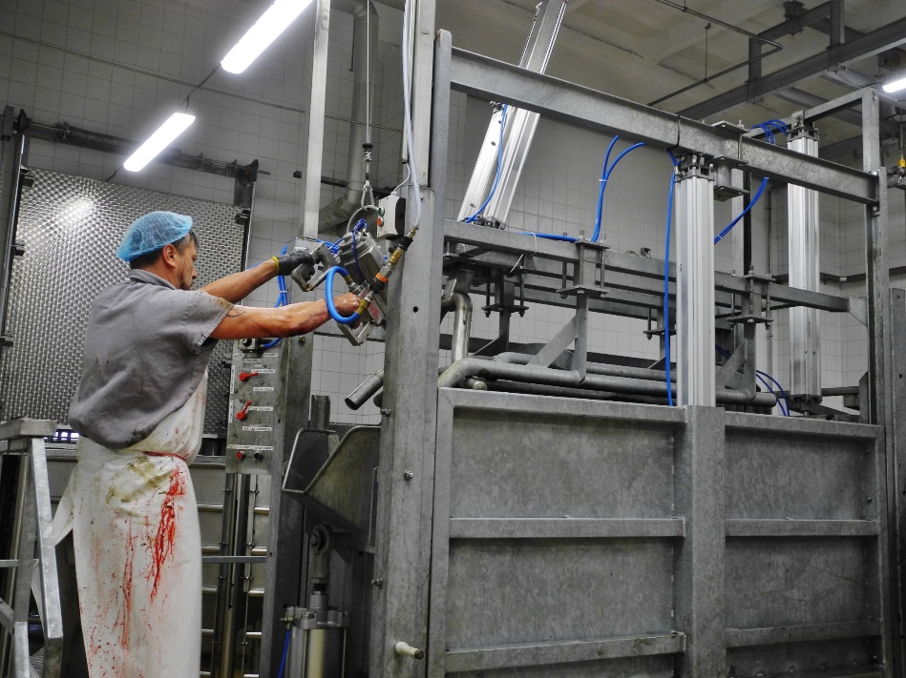
Every year, at least 8.4 billion cattle, sheep, horses, rabbits, pigs, poultry, and goats as well as around 1.5 billion farmed fish are slaughtered in the European Union.
Czech Republic
Czech Statistical Office, 2021
Cattle, pigs, small ruminants and horses
Slaughterhouse: 2 707 633 animals
Out of slaughterhouse: 83 715 animals
Notes:
https://vdb.czso.cz/vdbvo2/faces/cs/index.jsf?page=vystup-objekt&pvo=ZEM13A&z=T&f=TABULKA&skupId=1913&katalog=30840&pvo=ZEM13A&evo=v831_!_ZEM13A-2022_1&evo=v460_!_ZEM13Ajatka_1

Slide 7
Numbers of veterinary inspections of slaughter animals
Animal category | 2022 | Animal category | 2022
cows | 108 638 | horses and foals | 59
heifers | 28 201 | chicken | 115 610 289
other cattle | 95 688 | hens and roosters | 2 293 948
calves | 7 673 | turkey | 171 607
all cattle | 240 200 | scavenging fowl | 118 075 844
sow | 57 055 | ducks and geese | 3 707 204
other pigs | 2 221 130 | rabbits and nutria | 646 914
all pigs | 2 278 185 | Palaeognathae | 1 150
sheep and lambs | 8 560 | crocodiles | 0
goats and goat kids | 998 | All animals | 124 959 114

Slide 8
Scientific articles
Welfare of Farm Animals During Transport
The Duration and Conditions During the Journey
Mortality and Injuries of Animals
Animal Welfare During Slaughter
Animal Handling and Restraint
Stunning Methods – Accuracy and Efficiency
Quality of Stunning – Assessing of Signs of Unconsciousness/Consciousness
Notes:
All farm animals deserve a humane end to their lives.

Slide 9
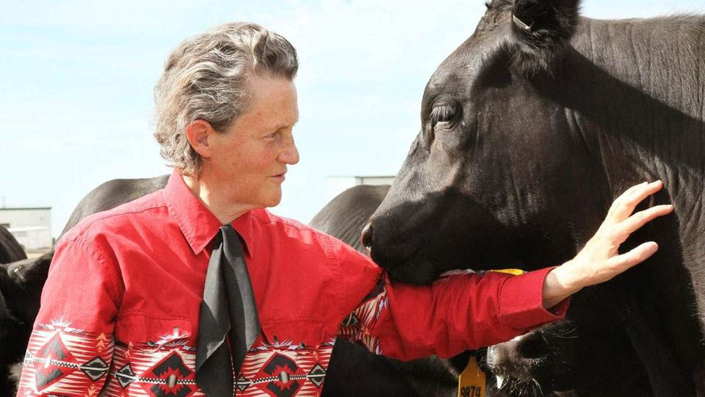
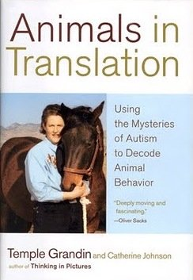
Dr. Temple Grandin
https://www.youtube.com/watch?v=RoNErsJNPzw
Behavioral Principles of Livestock Handling
Making slaughterhouses more humane for cattle, pigs, and sheep
Dr. Temple Grandin's Website
Notes:
https://www.templegrandin.com/
She is currently a faculty member with Animal Sciences in the College of Agricultural Sciences at Colorado State University.
Selected academic works
Making slaughterhouses more humane for cattle, pigs, and sheep

Slide 10
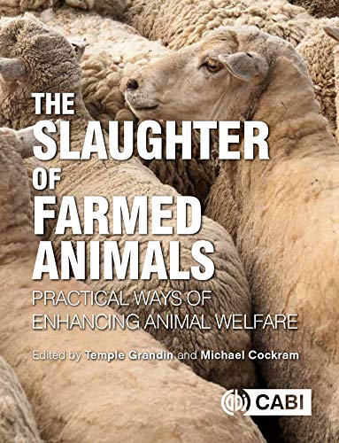
The slaughter of farmed animals: practical ways of enhancing animal welfare

Slide 11
Legislation regulating farm animal welfare at stunning and slaughter
European:
COUNCIL REGULATION (EC) No 1099/2009 of 24 September 2009
on the Protection of Animals at the Time of Killing
https://eur-lex.europa.eu/
Czech:
246/1992 Coll., Act of the Czech National Council
on the Protection of Animals Against Cruelty
418/2012 Coll., Decree
on the Protection of Animals During Killing
Notes:
https://food.ec.europa.eu/animals/animal-welfare/animal-welfare-practice/slaughter-stunning_en
https://www.youtube.com/watch?v=RoNErsJNPzw
https://food.ec.europa.eu/animals/animal-welfare/animal-welfare-practice/slaughter-stunning/2018-factsheets_en
https://www.eurogroupforanimals.org/files/eurogroupforanimals/2021-12/2021_05_11_efa_pb_Animal%20Welfare%20at%20the%20time%20of%20killing%20and%20slaughter.pdf

Slide 12
Legislation regulating farm animal at stunning and slaughter
European:
2019/624, 2019/627, 2017/625, 853/2004
Czech:
166/1999 Coll., on Veterinary Care
Notes:
https://food.ec.europa.eu/animals/animal-welfare/animal-welfare-practice/slaughter-stunning_en
https://www.youtube.com/watch?v=RoNErsJNPzw
https://food.ec.europa.eu/animals/animal-welfare/animal-welfare-practice/slaughter-stunning/2018-factsheets_en
https://www.eurogroupforanimals.org/files/eurogroupforanimals/2021-12/2021_05_11_efa_pb_Animal%20Welfare%20at%20the%20time%20of%20killing%20and%20slaughter.pdf
TROUBLE YOU

Slide 13
Production of educational materials
on protection of animals
at the time of killing
Factsheets
How to Handle and Restrain
How to Stun
How to Stun/Kill On-Farm
Notes:
The animated video focuses on the protection of animals at the time of slaughter, in the context of small slaughterhouses in the EU. The animation will be a generic introduction to slaughterhouse owners as well as managers aware of the availability of the best practices and their interests and benefit in applying them.

Slide 14
An Open Learning Package Produced and published by the Humane Slaughter Association (HSA) (1995)
https://www.youtube.com/watch?v=8eGopnYXp9E&t=9s
Notes:
Training package for all those handling and slaughtering cattle, sheep and pigs
https://www.youtube.com/watch?v=8eGopnYXp9E

Slide 15
Slaughtering process
the handling and care
of animals before they are restrained
the restraint of animals
for the purpose of stunning or killing;
the stunning
of animals
the shackling or hoisting
of live animals
the bleeding
of live animals
the slaughtering
Postmortem veterinary inspection
Meat processing
the assessment of effective stunning
Notes:
the handling and care of animals before they are restrained;

Slide 16
The handling and care of animals before they are restrained
In slaughterhouse only workers holding certificate of competence
The arrival, moving and handling of animals
Animals shall be unloaded as quickly as possible after arrival and subsequently slaughtered without undue delay.
Mammals (X rabbits and hares) , which are not taken directly upon arrival to the place of slaughter, shall be lairaged and shall have drinking water available.
Animals which have not been slaughtered within 12 hours of their arrival shall be fed, the animals shall be provided an appropriate amount of bedding.
Specific requirements for animals in containers.
https://youtu.be/8eGopnYXp9E?t=1361

Slide 17
The order of animals at slaughter:
unweaned animals, lactating dairy animals, females having given birth during the journey or animals delivered in containers
the others
If this is not possible:
milking dairy animals at intervals of not more than 12 hours;
providing appropriate conditions for suckling and the welfare of the newborn animal
providing water in the case of animals delivered in containers.

Slide 18
Prohibited methods of handling
strike or kick the animals
apply pressure to any particularly sensitive part of the body in such a way as to cause animals avoidable pain or suffering
lift or drag the animals by the head, ears, horns, legs, tail or fleece, or hand let hem in such a way as to cause them pain or suffering;
X poultry, rabbits and hares;
use prods or other implements with pointed ends
twist, crush or break the tails of animals or grasp the eyes of any animal.

Slide 19
Using of electric prods
The use of instruments which administer electric shocks shall be avoided as far as possible.
shall only be used for adult bovine animals and adult pigs which:
refuse to move
they have room ahead of them in which to move.
the shocks shall last no longer than 1 sec.
shall only be applied to the muscles of the hindquarters.
not be used repeatedly if the animal fails to respond.

Slide 20
Animal behaviour – handling
Cattle
strongly developed herd instinct
isolation and mixing of individual social groups - it causes fights
cannot distinguish detail and distance, he doesn't like the dark, he gets scared easily
Small RU
easy to handle, isolation upsets them, rams can be aggressive
long distance: they only recognize moving objects
Pigs
Not so well-developed following instinct
they are prone to stress, so you need to handle them with care, no brute force is used.
wide field of vision field
Notes:
https://youtu.be/8eGopnYXp9E?t=1237

Slide 21
Principle of escape zones
https://youtu.be/8eGopnYXp9E?t=1237
Notes:
DIRECT MOVEMENT

Slide 22
During or after
unloading of animals
Emergency killing
Animals which are unable to walk shall not be dragged to the place of slaughter, but shall be killed where they lie.
https://youtu.be/8eGopnYXp9E?t=2948
Notes:
https://youtu.be/8eGopnYXp9E
?t=2948

Slide 23
Conditions for animals in lairage
enough space to stand up, lie down and, except for cattle kept individually, turn around.
kept securely in the lairage and care shall be taken to prevent them from escaping and to protect them from predators.
The condition and state of health of the animals in a lairage shall be regularly inspected by the animal welfare officer or a person having appropriate competence

Slide 24
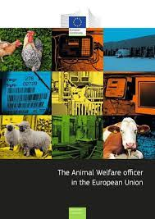
Animal welfare officer in slaughterhouse
slaughterhouses slaughtering more than 1 000 livestock units of mammals or 150 000 birds or rabbits per year.
The welfare conditions of animals from their arrival to their slaughter.
Notes:
https://www.slideshare.net/ptwp/brochure-24102012-en-14931047

Slide 25
Appropriate lairage facility
ventilation systems, an alarm and emergency back-up facilities
shall be designed and constructed so as to minimise the risk of injuries to the animals and the occurrence of sudden noises.
providing space for the inspection of the animals.
fixed or portable lighting
Appropriate pens, passageways and races
waiting pen: a level floor
free movement of animals, small RU and SU: walk side by side, except in the case of races leading to the restraining equipment
Ramps and bridges
lateral protection to ensure that animals cannot fall off.
Minimise the risk of animals slipping, falling or injuring their feet.
Notes:
Kotce, naháněcí uličky a průchody

Slide 26
Veterinary inspection
Ante mortem and post mortem inspection
the longest-functioning surveillance systems
ensuring the health safety of food and feed
protection of human health
protection of animal health
Feedback from slaughterhouses is of indisputable importance to successful herd management
official veterinary inspectors
Data archived in the IS of the SVA
Notes:
one of the most widespread and longest-functioning surveillance systems
Data from veterinary inspection is avaluable tool in monitoring the health and welfare of slaughtered animals, and can provide information relevant to the assessment of their living conditions
impact on the attainment of meat of high quality from slaughter animals
A carcass inspection not only provides an awareness of the quality and safety of ani-mal products, but also gives a comprehensive overview of the slaughtered animal’s health
controlling the quality and safety of animal products, but are also an appropriate source of data for monitoring a wide range ofdiseases and conditions relating to the health and living conditions of animals the occurrence of disease and the individual’s state of health itself are also important factors influencing animalwelfare

Slide 27
Ante mortem inspection
To ensure that only apparently healthy, physiologically normal animals are slaughtered for human consumption and that abnormal animals are separated and dealt with accordingly.
Identity of animals
Handling with animals during unloading
Movement and reaction of animals
Occurence of diseases – clinical signs
Visible injuries
Cleanliness of animals
BCS
No pregnant animals
individual observing
Notes:
https://www.fao.org/3/t0756e/T0756E01.htm
suspicion

Slide 28
The restraint of animals
Correct restraint
= efficient stunning and bleeding
and preventing from the suffering
optimise the application
of the stunning or killing method
prevent injury to the animals
minimise struggle and vocalisation
minimise the time of restraint.
https://youtu.be/8eGopnYXp9E?t=2874
Notes:
restraining boxes used in conjunction with a pneumatic captive bolt shall be fitted with a device that restricts both the lateral and vertical movement of the head of the animal.

Slide 29
individual restraining box
stun pen
conveyor system
https://youtu.be/8eGopnYXp9E?t=2028
Notes:
https://youtu.be/8eGopnYXp9E?t=2028

Slide 30
The stunning of animals
stunning and follow-up act. only workers with education
Animals shall only be killed after stunning in accordance with the methods and specific requirement
The loss of consciousness and sensibility shall be maintained until the death of the animal.
X Ritual slaughter
Halal and kosher slaughter
https://www.grandin.com/ritual/rec.ritual.slaughter.html
Pros and cons of different stunning methods from a Halal perspective: a review
https://www.ncbi.nlm.nih.gov/pmc/articles/PMC8633638/
Notes:
At least butcher
Loss of consciousness is defined as a state of temporary or permanent
loss of the functions of the brain
The animal is slaughtered, without being stunned, with a razor sharp knife.
https://www.grandin.com/ritual/rec.ritual.slaughter.html
Unconsciousness can be reversible or irreversible.

Slide 31
Stunning Methods
More information in Annex 1, 1099/2009
Mechanical methods
penetrative captive bolt device, non-penetrative captive bolt device, firearm with free projectile, maceration, cervical dislocation, percussive blow to the head
Electrical methods
head-only electrical stunning, head-to-body electrical stunning, electrical waterbath
Controlled atmosphere methods
Carbon dioxide at high concentration, Carbon dioxide in two phases, Carbon monooxide, inert gases, Low atmospheric pressure stunning
Notes:
ANNEX I
more liberal

Slide 32
Use of stunning equipment
ensure that during stunning operations appropriate back-up equipment is immediately available on the spot and is used in the case of failure of the stunning equipment initially used. The back-up method may differ from that first used.

Slide 33
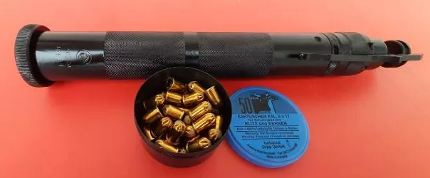
Mechanical methods
Penetrative captive bolt device
cartridge-fired captive-bolt /the pneumatically powered captive-bolt devices
irreversible unconsciousness
https://youtu.be/8eGopnYXp9E?t=2271
Notes:
For all animals
The penetrating
captive-bolt device is the most widespread equipment used to stun
cattle around the world
pneumatically powered captive-bolt device, which is used primarily in high capacity abattoirs
Cartridge-fired
captive-bolt stunning was performed using a device in which the
captive bolt (steel tip), when fired from the stunning pistol,
penetrates the skull at the site at which it is placed to the skull and
penetrates the brain to the depth of the bolt (steel tip). It causes
mechanical damage
Diffferent cartridge According to the the weight and category of animals
Pneumatic stunning
was performed with a device in which the captive bolt (steel tip) is
fired by compressed air. The bolt penetrates the skull at the site at
which the stunning pistol is placed to the skull, and the compressed
air is also forced through the opening into the skull and causes
mechanical damage
The stunning device uses a
pressure of 14 bar.

Slide 34
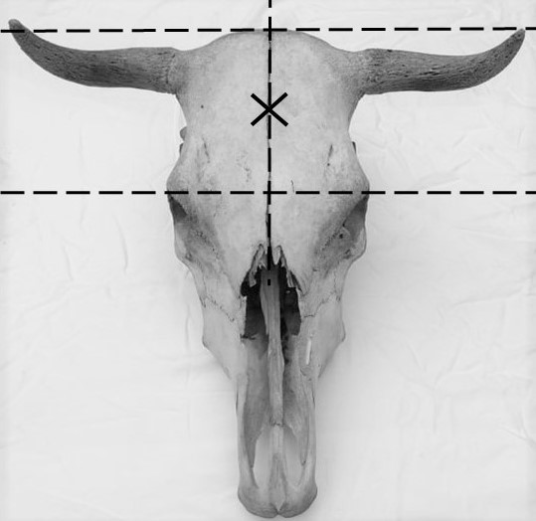
Ideal point for stunning and correct angle of stunning
a point halfway on a midline perpendicular to horizontal lines drawn over the top of the poll and between the lateral canthus of each eye.
Intersection of two diagonal lines between the base of each horn and the contralateral eye.
418/2012 Coll., Decree
on the Protection of Animals During Killing
Notes:
the shot must be shot /aimed perpendicular to the frontal bone

Slide 35
Comparison of accuracy and efficiency of used device in cattle
 | cartridge-fired captive-bolt device |  | pneumatically powered captive-bolt device
 | n | % | n | %
All slaughtered animals | 382 | 100,00 | 396 | 100,00
Repeat stunning | 70 | 18,32 ª | 23 | 5,81 ^{b}
Position deviation | 130 | 34,03 ª | 98 | 24,75 ^{b}
Angle deviation | 181 | 47,38 a | 38 | 9,60 b
a,b percentages in the same row with different superscripts differ (p ˂ 0.01)
Notes:
Efficiency of stunning
Our results showed that it was much more difficult to achieve the
ideal shot angle during cartridge
-fired stunning
Reduction of the occurrence of incorrect stunning and the occurrence of reflexes and reactions in cattle after pneumatically powered captive-bolt stunning in comparison with cartridge-fired captive-bolt stunning
výběrem omračovacího přístroje lze ovlivnit účinnost i kvalitu samotného omráčení. Pneumatický omračovací přístroj ve srovnání s jatečnou pistolí snížil míru opakovaných výstřelů nutných k dosažení pádu zvířete a jeho motorické paralýzy, zvýšil přesnost v poloze a směru omračující rány, a také omezil výskyt reakcí a reflexů spojených s přítomností vědomí nebo rizikem nabytí vědomí. Výrazně vyšší účinnosti a kvality omráčení lze použitím pneumatického omračovacího přístroje dosáhnout zejména u býků, kdy v případě krav a jalovic je odpovídajícího omráčení možné ve většině případů dosáhnout i prostřednictvím jatečné pistole. Tato práce poskytla důkaz o tom, že v každodenní praxi jatečného provozu má pneumatické omračování potenciál přispět ke zlepšení úrovně welfare poráženého skotu. U býků, krav i jalovic snižuje při správném technologickém postupu uplatněném pracovníkem na jatkách riziko nedostatečného omráčení a tím narušení welfare na minimum.

Slide 36
The assessment of effective stunning
Quality of stunning
persons responsible for stunning carry out regular checks to ensure that the animals do not present any signs of consciousness or sensibility in the period between the end of the stunning process and death (sufficiently representative sample of animals)
Ritual slaughter: the animals do not present any signs of consciousness or sensibility before being released from restraint and do not present any sign of life before undergoing dressing or scalding.

Slide 38
Notes:
Mezi průkazné znaky bezvědomí autoři uvádějí ztrátu normálního postoje bez přítomnosti vzpřimovacích reflexů, nepřítomnost rohovkového reflexu a nepřítomnost rytmického dýchání. Absence těchto příznaků je ukazatelem odpovídající kvality omráčení dle současných vědeckých poznatků (Terlouw, 2020).

Slide 39
Repeat stunning

Slide 40
A comparison of the occurrence of reflexes/ reactions in all cattle following the stun shot with a cartridge fired captive-bolt device and a pneumatically powered captivebolt device.
pneumatically powered captive-bolt device
cartridge-fired captive-bolt device
a,b percentages in the sign with different superscripts differ (p ˂ 0.01),

Slide 41
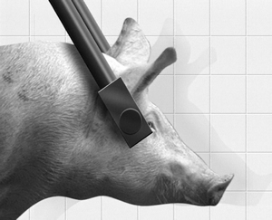
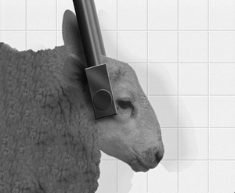
Electrical methods
electrodes for stunning of pigs and small RU
general response similar to epilepsy seizure
https://youtu.be/8eGopnYXp9E?t=3233
Notes:
minimum voltage (V), maximum frequency (Hz), minimum current exposure time, maximum time from stunning to bleeding injection / killing (s), device calibration frequency, current flow optimization, prevention electric shocks before stunning, contact location and size electrode surfaces

Slide 42
Electrical waterbath

Slide 43
Electrical waterbath stunning of poultry
Animals shall not be shackled if they are too small for the waterbath stunner or if shackling is likely to induce or increase the pain suffered (such as visibly injured animals). In these cases, they shall be killed by an alternative method.
Shackles shall be wet before live birds are shackled and exposed to the current. Birds shall be hung by both legs.
stunning shall be carried out in accordance with the minimum currents laid down therein, and animals shall be exposed to that current for a minimum duration of at least 4 seconds.

Slide 44
Shackle lines shall be designed in such a way that birds suspended on them will not remain hung conscious longer than one minute. However ducks, geese and turkeys: 2 minutes.
The size and shape of the metal shackles shall be appropriate to the size of the legs of poultry to be slaughtered so that electrical contact can be secured without causing pain.
5.6. The waterbath shall be designed in such a way that the level of immersion of the birds can be easily adapted.
Access to the waterbath stunning equipment shall be available to allow the bleeding of birds that have been stunned and remain in the waterbath as a result of a breakdown or delay in the line.
Waterbath stunning equipment shall be fitted with a device which displays and records the details of the electrical key parameters used. These records shall be kept for at least one year.

Slide 45
https://www.youtube.com/watch?v=d2E0wBjlClg

Slide 47
Controlled atmosphere methods
https://www.grandin.com/gas.stunning.poultry.eval.html
Notes:
6. Gas stunning equipment for pigs and poultry 6.1. Gas stunners, including conveyor belts, shall be designed and built to: (a) optimise the application of stunning by gas; (b) prevent injury or contusions to the animals; (c) minimise struggle and vocalisation when animals are restrained. 6.2. The gas stunner shall be equipped to measure continuously, display and record the gas concentration and the time of exposure, and to give a clearly visible and audible warning if the concentration of gas falls below the required level. The device shall be placed so as to be clearly visible to the personnel. These records shall be kept for at least one year. 6.3. The gas stunner shall be designed in a manner that, even at the maximum permitted throughput, the animals are able to lie down without being stacked on each other

Slide 48
Pig slaughter- Comparison of different stunning methods used
https://www.youtube.com/watch?v=adtjQDW9rVE
Electric Immobilization vs. Controlled-Atmosphere Killing in poultry
https://www.youtube.com/watch?v=u4smUBY0P1Q

Slide 49
The shackling or hoisting of live animals
Where one person is responsible for the stunning, shackling, hoisting and bleeding of animals, that person shall carry out all those operations consecutively on one animal before carrying out any of them on another animal.

Slide 50
The bleeding of live animals
Methods which ensure simple stunning shall be followed as quickly as possible by a procedure ensuring death such as bleeding, pithing, electrocution or prolonged exposure to anoxia.
https://youtu.be/8eGopnYXp9E?t=3618 https://youtu.be/8eGopnYXp9E?t=2971
Notes:
https://youtu.be/8eGopnYXp9E?t=2971

Slide 51
Time between the stunning and bleeding
Bleed the cattle within 60 seconds of stunning
Bleed the sheep within 8 * seconds of stunning
Bleed the pigs within 20 seconds of stunning
mechanical/electrical/controlled atmosphere methods (30 s)
Emergency killing: using of firearm with free projectile
mistake in materials: https://food.ec.europa.eu/system/files/2021-08/aw_prac_slaughter_factsheet-2018_stun_sheep_en.pdf

Slide 52
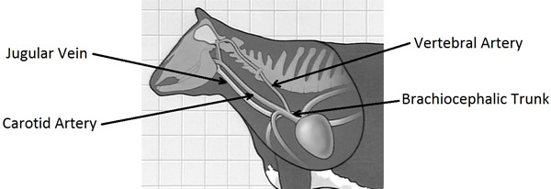
Bleeding in case of simple stunning or ritual slaughter
the two carotid arteries or the blood vessels from which they arise shall be systematically severed. Electrical stimulation shall only be performed once the unconsciousness of the animal has been verified.
Bleeding should be carried out by an incision made with a sharp knife in the jugular furrow at the base of the neck, the knife being directed towards the entrance of the chest to sever all the major blood vessels arising from the heart.
In the interest of good hygiene two knives should be used, the first to open the skin and the second to sever the blood vessels. This procedure is often referred to as 'sticking'.

Slide 53
Sheep and Goats
Bleeding may be carried out in a similar way as for cattle or by an incision made close to the head using a blade at least 120mm long to sever both carotid arteries and both jugular veins, i.e. a cut across the throat. In the EU, the trachea and oesophagous of animals intended for human consumption must remain intact during bleeding, except in the case of slaughter according to a religious custom. An incision at the entrance to the chest must therefore be used.
Pigs
A knife at least 120mm long should be inserted in the mid-line of the neck at the depression before the breast bone, and the skin raised with the knife point using light pressure and a lifting movement. When penetration has been made, the knife handle should be lowered so that the blade is in a near-vertical position, and pushed upward to sever all the major blood vessels which arise from the heart
Notes:
https://www.hsa.org.uk/bleeding-and-pithing/bleeding

Slide 54
Birds
Birds shall not be slaughtered by means of automatic neck cutters unless it can be ascertained whether or not the neck cutters have effectively severed both blood vessels. When neck cutters have not been effective the bird shall be slaughtered immediately.
https://www.youtube.com/watch?v=uJXSYMhtwvU

Slide 55
Private domestic consumption
Killing of rabbits, hares and poultry during home slaughter
Rabbits, hares and poultry shall not experience undue pain or suffering during the home slaughter and related operations.
These animals may be shackled before the stunning only provided such measures are taken ensuring that, at the time of stunning, the animals are in such a physical condition which allows for efficient and fast stunning.
When killing poultry at home slaughter, bleeding may be performed by decapitation without prior stunning.
246/1992 Coll., Act of the Czech National Council
on the Protection of Animals Against Cruelty

Slide 56
Slaughtering of fish
Killing fish by bleeding may be performed only after its prior stunning ensuring the loss of sensibility and the loss of consciousness which last throughout the bleeding. Slaughterhouse dressing of fish prior to its bleeding shall be prohibited.
Bleeding of fish upon sale shall be performed after stunning by a heavy percussive blow delivered to the top of the head and by cutting gill arches or the spinal cord and the vessels right behind the head.
Industrial processing of fish: the fish can be stunned by a device using alternating current with the voltage of 230 V, the processing of fish immediately after its slaughter.
246/1992 Coll., Act of the Czech National Council
on the Protection of Animals Against Cruelty

Slide 57
Prohibited methods of killing of animals
drowning or other methods of suffocating, including the administration of muscle relaxants,
administration of such substances and products, the dose of which does not induce deep general anaesthesia in the animal and does not cause subsequently certain death,
beating to death, stabbing to death or other methods causing undue pain or suffering to an animal,
use of electric current, unless an immediate loss of consciousness occurs,
use of adhesives or other similar means causing long lasting restriction of the movement of an animal which results in the death of an animal due to the lack of food or liquid or as a consequence of other metabolic disorders,
freezing, except for gradual freezing of snakes.

Slide 58
Meat processing
Further dressing or scalding shall only be performed once
the absence of signs of life of the animal has been verified.
no earlier than 30 seconds after bleeding

Slide 59
Veterinary inspection
Ante mortem and post mortem inspection
the longest-functioning surveillance systems
ensuring the health safety of food and feed
protection of human health
protection of animal health
Feedback from slaughterhouses is of indisputable importance to successful herd management
official veterinary inspectors
Data archived in the IS of the SVA
Notes:
one of the most widespread and longest-functioning surveillance systems
Data from veterinary inspection is avaluable tool in monitoring the health and welfare of slaughtered animals, and can provide information relevant to the assessment of their living conditions
impact on the attainment of meat of high quality from slaughter animals
A carcass inspection not only provides an awareness of the quality and safety of ani-mal products, but also gives a comprehensive overview of the slaughtered animal’s health
controlling the quality and safety of animal products, but are also an appropriate source of data for monitoring a wide range ofdiseases and conditions relating to the health and living conditions of animals the occurrence of disease and the individual’s state of health itself are also important factors influencing animalwelfare

Slide 60
Post mortem inspection
Pathological findings connected with welfare problems (LIMBS)
Cows
Heifers
Bulls
Calves
acute
chronic
traumatic

Slide 61
Notes:
Emaciation and stunted growth
Diarhea and respiratory syndrom

