Slide 1
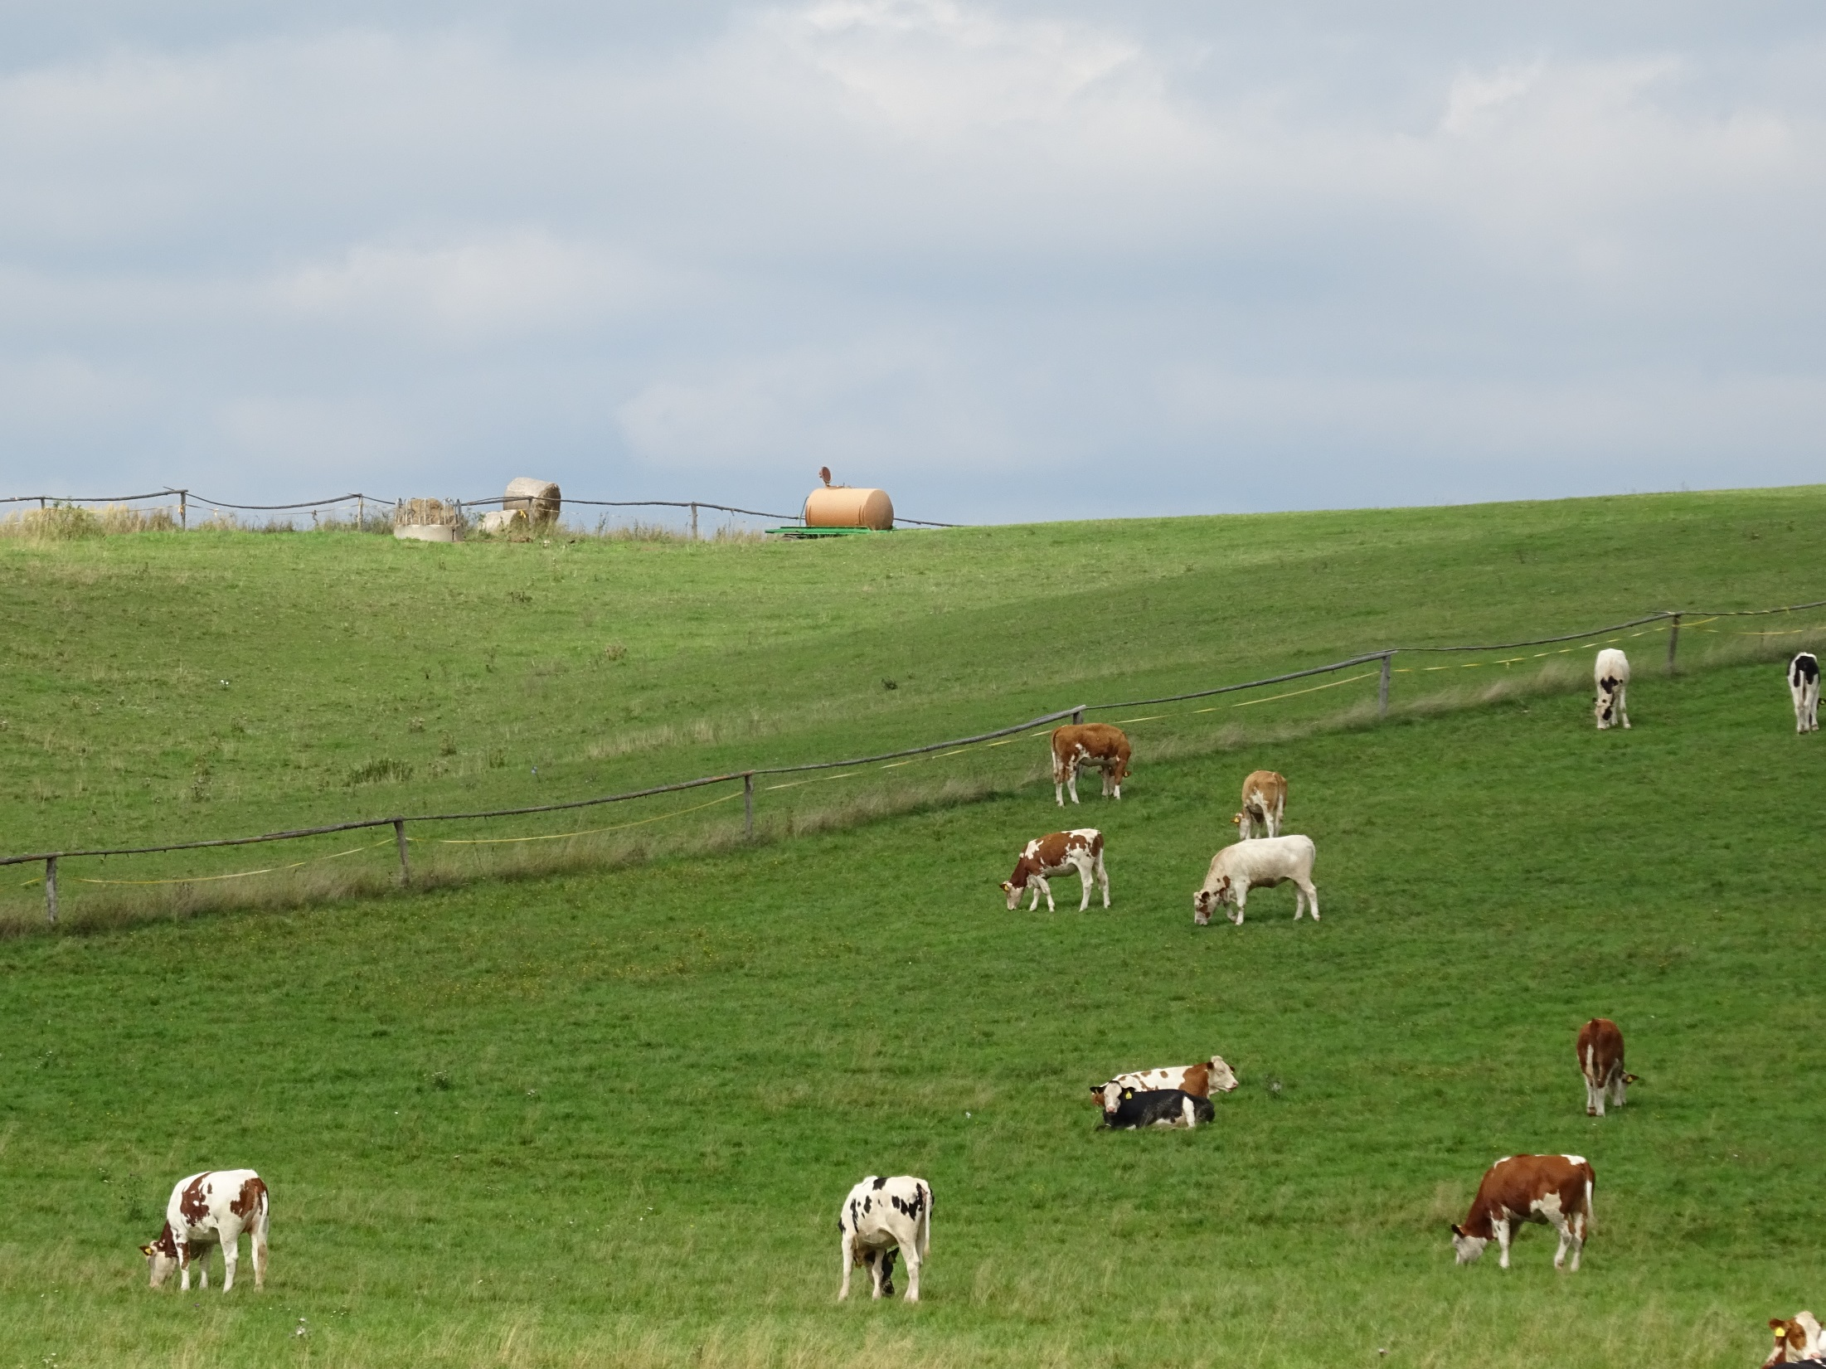
Welfare of farm animals
Practical course 1

Slide 2
Teachers
Guarantor and lectures
Assoc. Prof. MVDr. Vladimíra Pištěková, Ph.D. - pistekovav@vfu.cz
Practicals
MVDr. Monika Šebánková, Ph.D. - sebankovam@vfu.cz
MVDr. Michal Kaluža, Ph.D. - kaluzam@vfu.cz

Slide 3
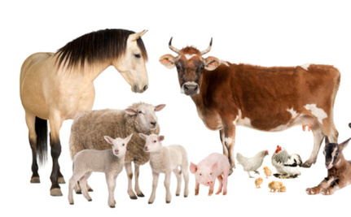
Welfare of livestock
Include knowledge of the biology, ethology and physiology of animals
Optimal conditions of farm animals are dependent on human care
Knowledge of the breeding and housing system are essential for livestock

Slide 4
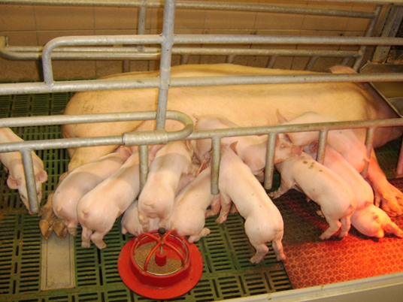
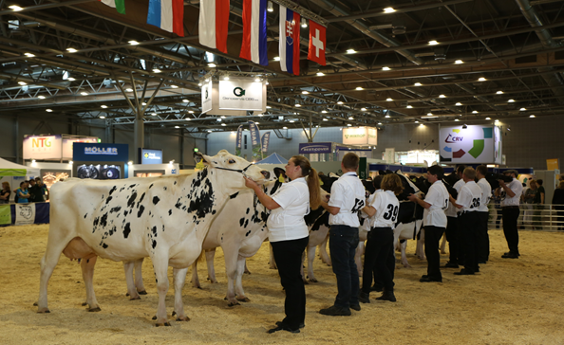
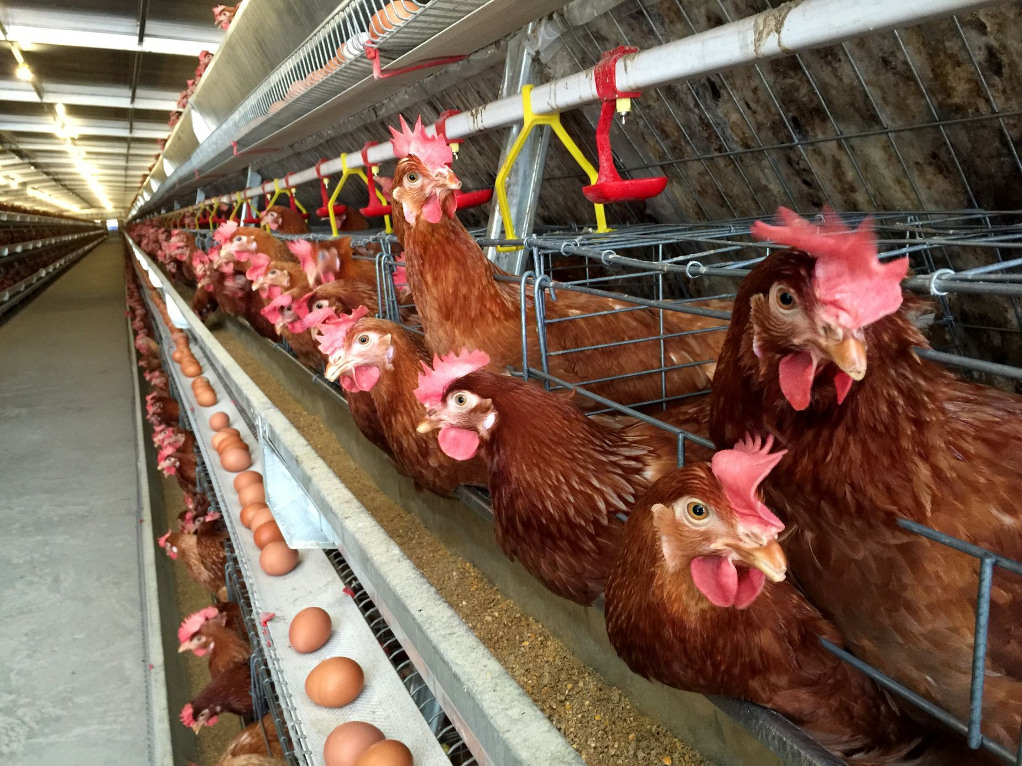
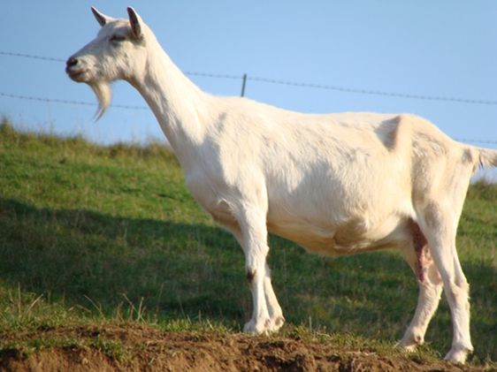
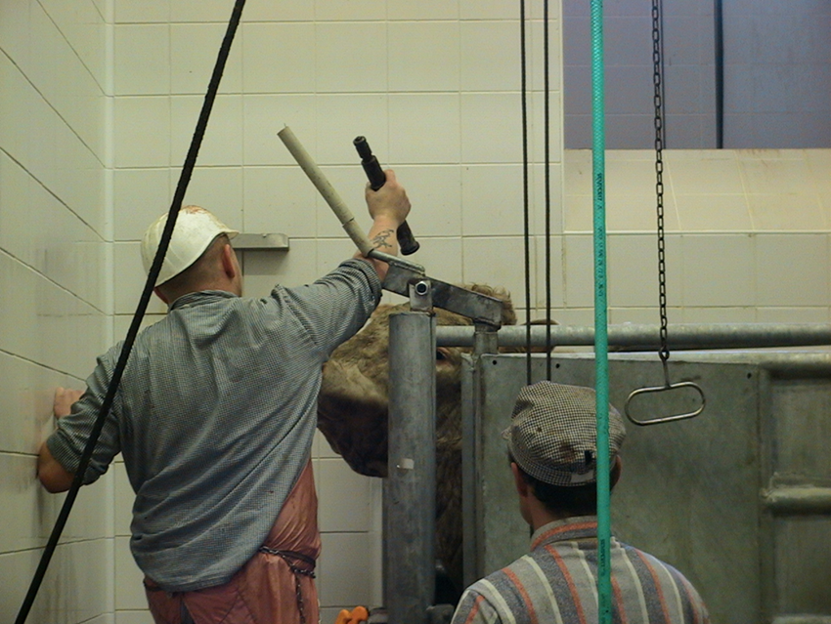
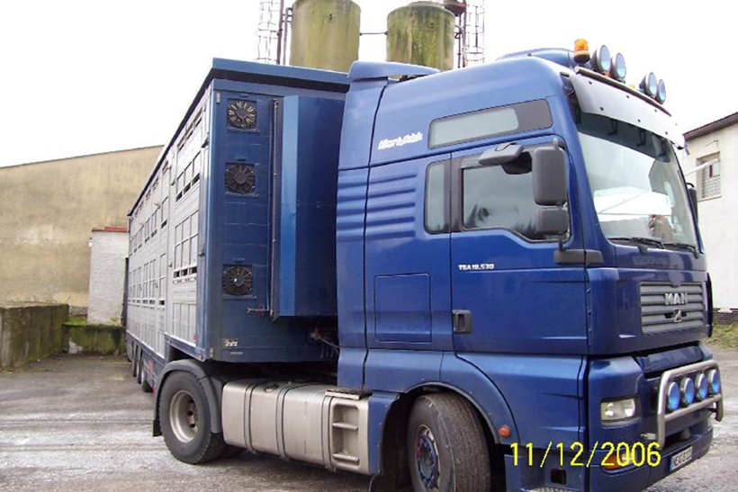
We will be interested in protection on farms, during transports and at the time of slaughter.

Slide 5
Syllabus- practical sessions:
1. Welfare of livestock, introduction to the issue. Semester work assignment - evaluation of the level of animal welfare in a selected livestock farm. 2. Welfare of dairy and beef cattle - principles of handling and handling of animals (practical video demonstration). The most common problems in cattle welfare. Model examples. 3. Welfare of pigs - principles of animal handling and handling (practical video demonstration). Model examples. 4. Welfare of sheep and goats - principles of animal handling and handling (practical video demonstration). The most common problems in sheep and goat welfare. Model examples. Presentation of the most common problems in sheep and goat welfare. 5. Welfare of poultry - poultry welfare problems associated with the way they are kept (practical video demonstration). The most common welfare problems in poultry. Solutions to model examples. 6. Welfare of ducks, geese and turkeys. Solving model examples. Most common welfare problems in waterfowl and turkeys. 7. Assessing livestock welfare at the exibitions, markets and during transport. 8. Welfare of animals at stunning and slaughter. Practical video demonstration of livestock slaughter. 9. - 12. practicals. Welfare of livestock - housing technology, nutrition, diseases and their impact on animal welfare (one-day trip to the school farm in Kunin). 13. Presentation of a semester study - evaluation of the level of animal welfare in a selected livestock farm. 14. self- study
Notes:
The main part of the course will be focused on minimum standards of farm animals

Slide 6
Literature
Notes:
literature will be available from prof. Pištěková or in the library

Slide 7
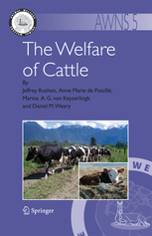
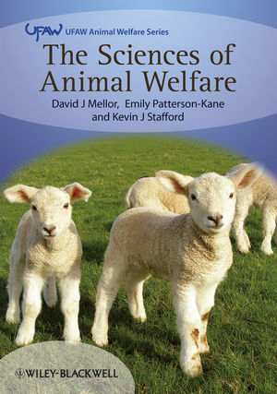
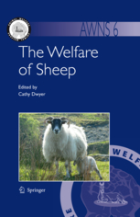
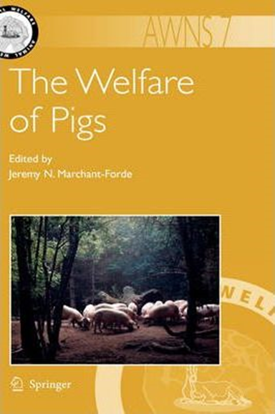
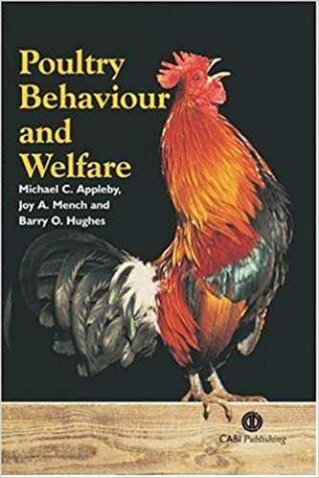
Notes:
Celkem tedy = 2434 stran ☺

Slide 8
Legislation regulating farm animal welfare
208/2004 Czech decree on Minimum standards for the protection of farm animals​
246/1992 the Czech National Council on the Protection of Animals Against Cruelty (e.g. transport)​
COUNCIL DIRECTIVE 98/58/EC concerning the protection of animals kept for farming purposes​
COUNCIL DIRECTIVE 2008/119/EC laying down minimum standards for the protection of calves​
COUNCIL DIRECTIVE 2007/43/EC laying down minimum rules for the protection of chickens kept for meat production​
Council Regulation 1099/2009/EC on the protection of animals at the time of killing​
Council Regulation (EC) No 1/2005/EC on the protection of animals during transport​

Slide 9
Credit requirements:
full attendance (1 excuse possible)
activity during practicals
3 tasks:
2 presentation
1 essay
Notes:
Practacals are oblikatory

Slide 10
Information and study materials
https://cit.vfu.cz/hzwelfare/

Slide 11
Credit requirements: Introduction of tasks

Slide 12
1. Presentation
2. - 7. week
Characteristics of the species
Decree No. 208/2004 Coll., Decree on minimum standards for the protection of livestock - elaboration of minimum standards for the protection of the assigned species - elaborate points, explain, examples, photos
3. week (5. 3. 2024) there will be no practical !

Slide 13
8. week topic Welfare during transport, markets, exhibition
Council Regulation (EC) No 1/2005/EC on the protection of animals during transport
other thesis obout welfare during markets, exhibition
9. week topic Welfare during stunning and slaughter
Council Regulation (EC) No 1099/2009 on the protection of animals at the time of killing
other thesis about private slaughter in your country or ritual slauther (= without stunning)

Slide 14
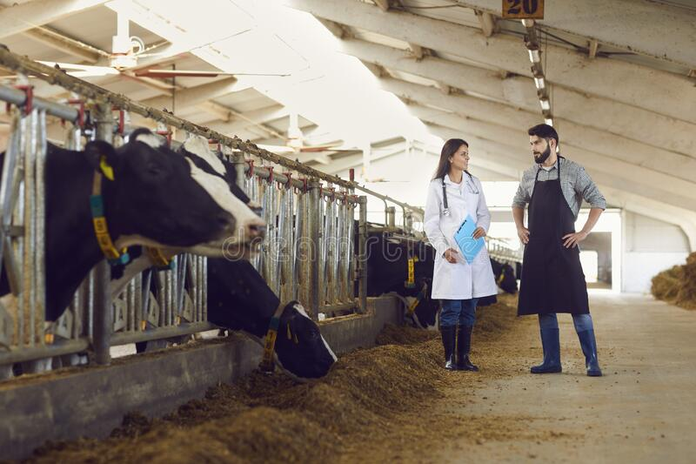
Animals welfare control in Czech republic
State Veterinary Administration (SVA) controls the welfare status of livestock farm. SVA does not use assessment protocols
Legislative requirements
essential for livestock is degree 208/2004 degree on minimum standards for the protection of farm animals​
An administrative infraction may be penalised

Slide 15
Minimal standards - summary
Concepts (Definition)
Minimum standards for livestock facilities
Generaly requiements for the keeping of livestock
Minimum standards for individual kind of farming animals and category
Notes:
your task for the next hour will be to prepare for the cattle

Slide 16
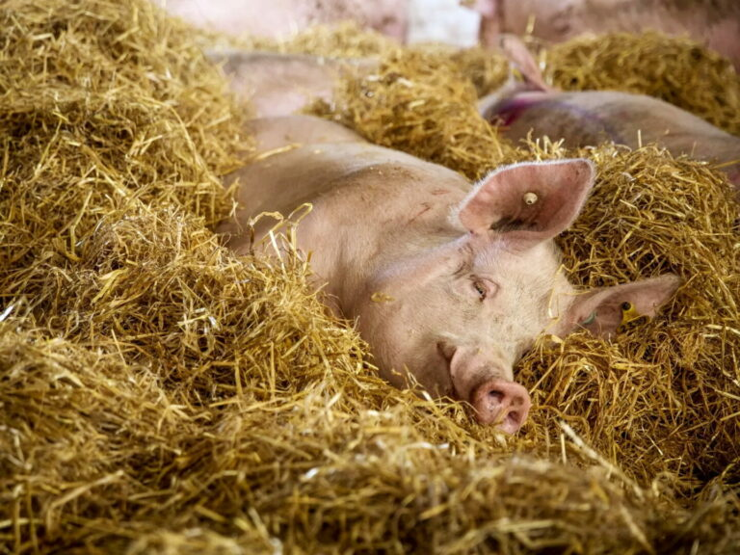
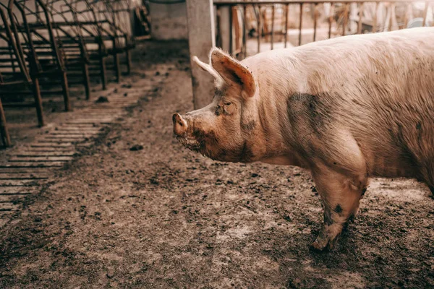
Minimum standards for livestock facilities
Stables are facilities for the housing of livestock
Stables must be designed to air circulation, dust, temperature and relative humidity, gas concentrations, lighting and noise are kept within limits that are not harmful to the animals.
Climatic conditoin are better

Slide 17
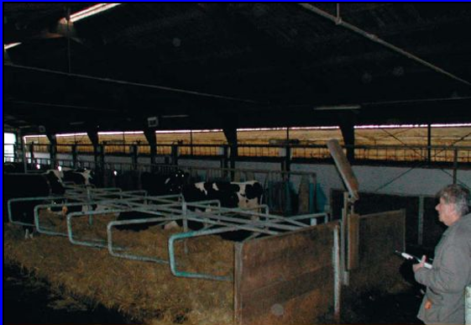
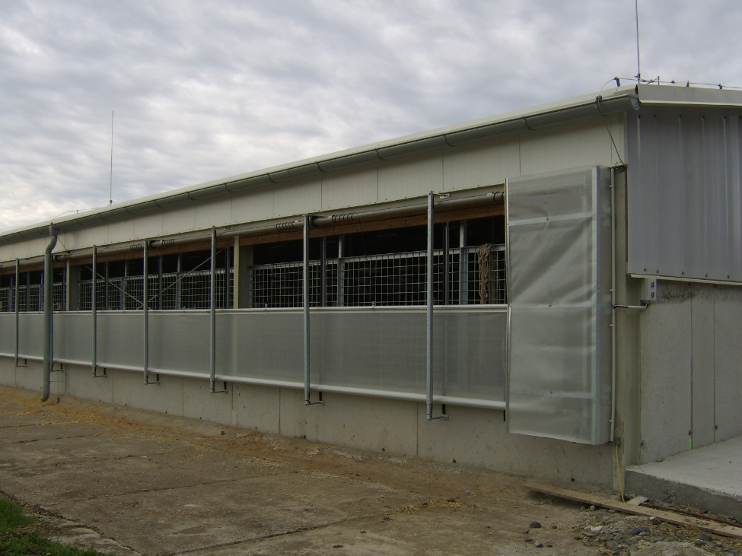
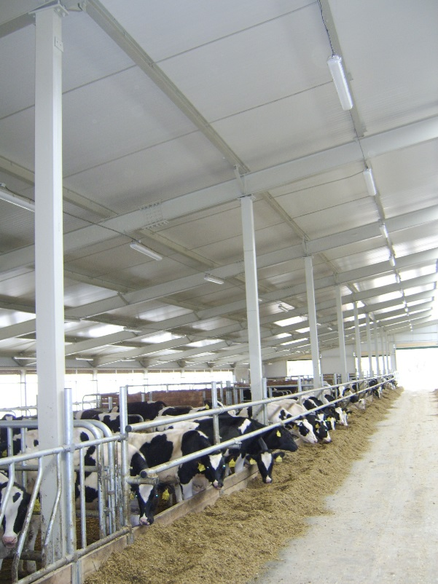
Lighting is not sufficient during day.
Is ventilation effective?
Light, clean and airy area

Slide 18
Cows - minimum stall dimensions​ (Annex 1)​

Slide 19
Presentation schedule
Week of semmester | Date | Topic | Student
2. week | 27. 2. 2024 | Cattle (dairy, beef)
3. | 5. 3. 2024 | free
4. | 12. 3. 2024 | Pigs
5. | 19. 3. 2024 | sheep and goats
6. | 26. 3. 2024 | Poultry (broilers, laying hens)
7. | 2. 4. 2024 | ducks, geese and turkeys
8. | 9. 4. 2024 | Transport, market and exhibition
9. | 16. 4. 2024 | Slaughtering

Slide 20
2.Practical lecture on the school farm in Nový Jičín
Safe the date 10. 5. 2024
Elaboration of information in the form of a text document fucusing on the knowledge gained on a trip to the farm
Choose one cattegory and describe: animals, their basic biological characteristics, health and care, housing system, nutrition, animal hygiene, etc.
+ conclusion (pros and cons, suggestions for improvement, violation of rules?)
Send to my email (as soon as posible)

Slide 21
3. Presentation of a semestral work: Evaluation of the level of welfare of livestock in the (private) small farm
You must visit another farm:
equestrian club/ farms animal in ZOO/ mini ZOO (www.lamacentrum.cz, www.navylet.cz/cs/cil/mini-zoo-jizansky-dvorek)
You choose the assesment method (5 Freedoms, WQ, AWIN, Assure well,…) and use indicators.
Evaluation of these protocols is difficult. You can make up own scoring/grading.
Presentation will be include: information about animal, breed, assesmet method, present what you see and evaluate, conclusion.
Presentation- 13. week (14. week)

Slide 22
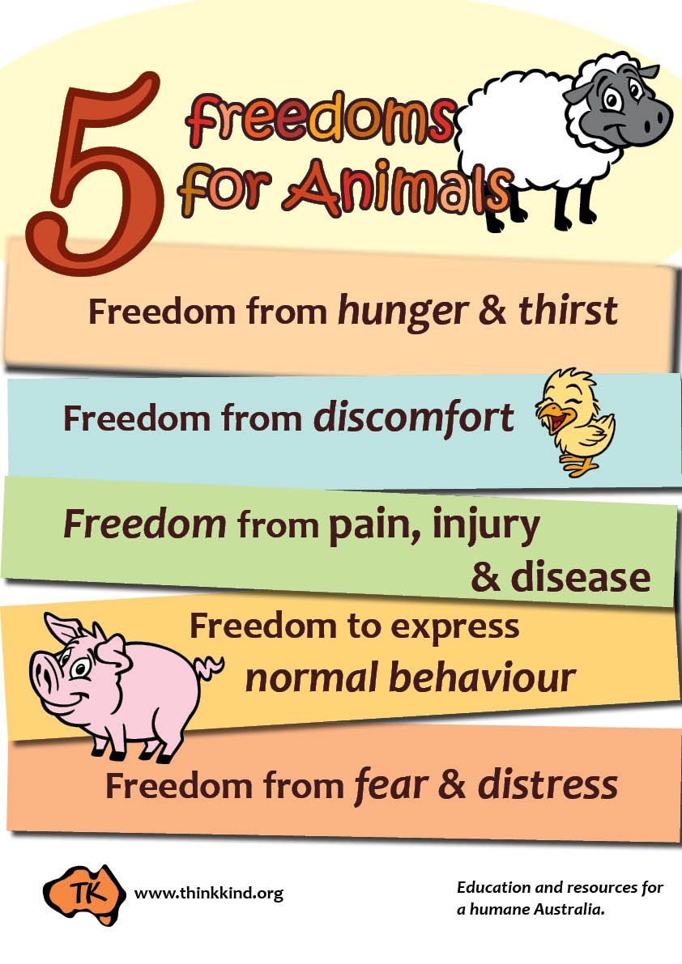
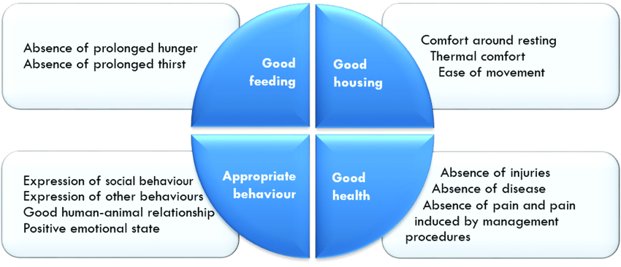
Assessment methods of animal welfare and indicators
Způsob hodnocení
Popis
AWIN protocol
You will talk about welfare assessment
methods in lectures​.
Notes:
if you know all the requirements for protection and wellbeing of animals you can evaluate its welfare according different methods

Slide 23
Next practicals
1 presantation about dairy and beef cattle
characteristics
Decree - Minimum standards for the protection of bovine animals
principles of handling and handling of cattle
(practical video demonstration)
The most common problems in cattle welfare
Model examples (we use the degree, you may bring copy or you can use your tablet)

Slide 24
Thanks you for your attention.

