Slide 1
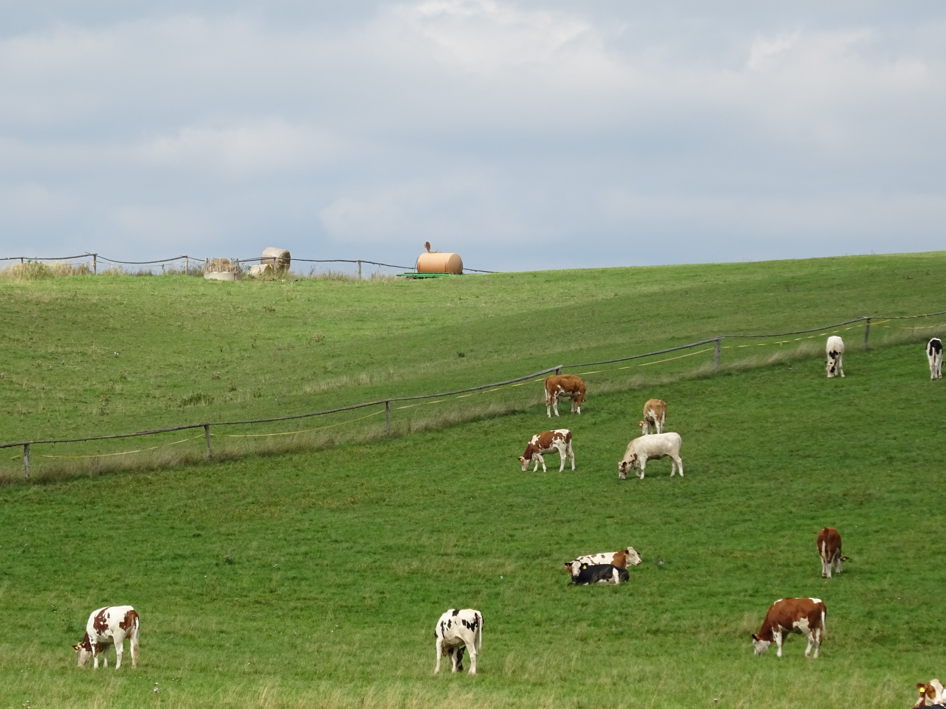
Welfare of farm animals
Practical course 1

Slide 2
Teachers
Guarantor and lectures
Assoc. Prof. MVDr. Vladimíra Pištěková, Ph.D. - pistekovav@vfu.cz
Practicals
Mgr. Lucie Veitová – veitoval@vfu.cz
Mgr. Zdeňka Vacušková - vacuskovaz@vfu.cz

Slide 3
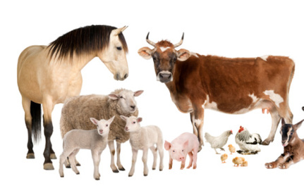
Welfare of livestock
Includes knowledge of the biology, ethology and physiology of animals
Optimal conditions of farm animals are dependent on human care
Knowledge of the breeding and housing system is essential for the livestock farming

Slide 4
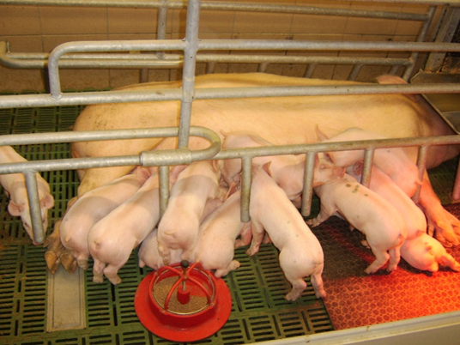
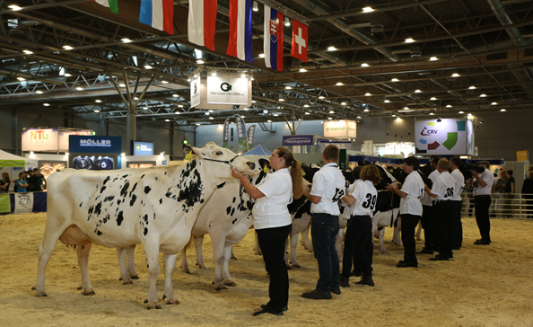
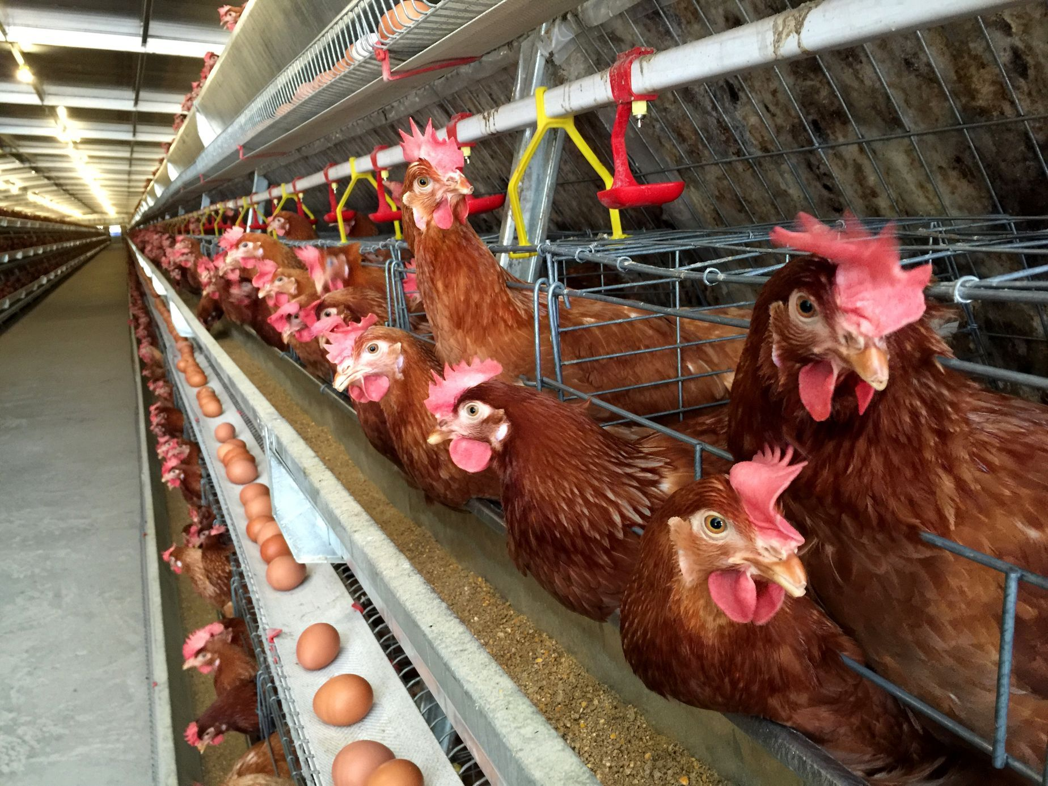
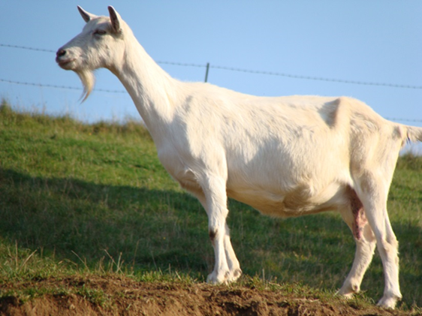
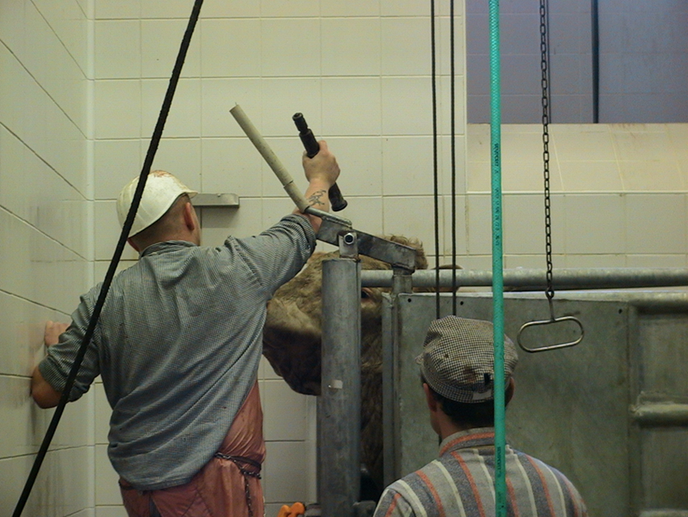
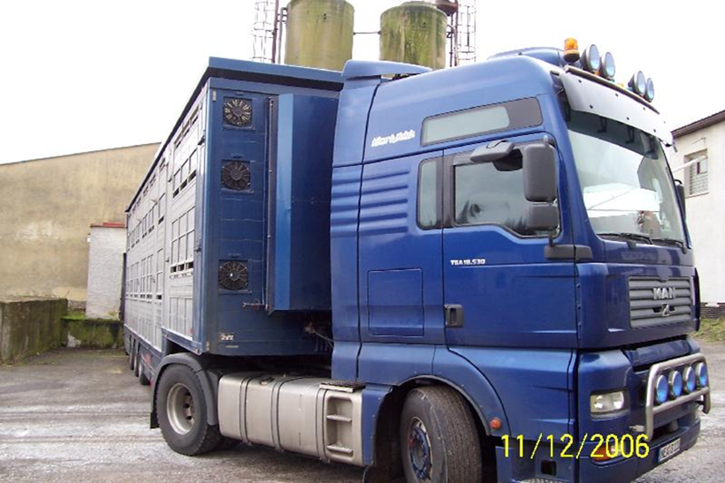
Welfare and protection on farms, during transports and at slaughter

Slide 5
Syllabus - practical sessions:
1. Welfare of livestock, introduction to the issue. Semester work assignment - evaluation of the level of animal welfare in a selected livestock farm.
2. Welfare of dairy and beef cattle - principles of handling and handling of animals (practical video demonstration). The most common problems in cattle welfare. Model examples.
3. Welfare of pigs - principles of animal handling and handling (practical video demonstration). Model examples.
4. Welfare of sheep and goats - principles of animal handling and handling (practical video demonstration). The most common problems in sheep and goat welfare. Model examples. Presentation of the most common problems in sheep and goat welfare.
5. Welfare of poultry - poultry welfare problems associated with the way they are kept (practical video demonstration). The most common welfare problems in poultry. Solutions to model examples.
6. Welfare of ducks, geese and turkeys. Solving model examples. Most common welfare problems in waterfowl and turkeys.
7. Assessing livestock welfare at the exhibitions, markets and during transport.
8. Welfare of animals at stunning and slaughter. Practical video demonstration of livestock slaughter.
9. - 12. practicals. Welfare of livestock - housing technology, nutrition, diseases and their impact on animal welfare (one-day trip to the school farm in Kunin).
13. Presentation of a semester study - evaluation of the level of animal welfare in a selected livestock farm.
14. Self- study
Notes:
The main part of the course will focused on minimum standards of farm animals

Slide 6
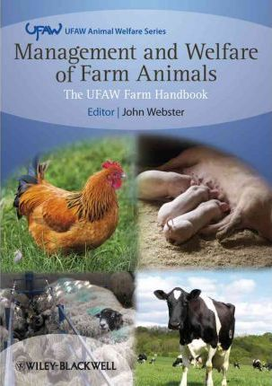

Literature
Notes:
Literature will be available from prof. Pištěková or in the library

Slide 7
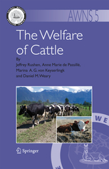
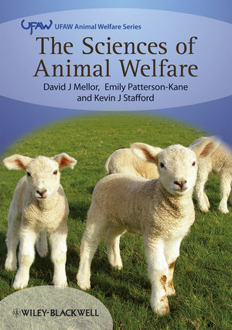
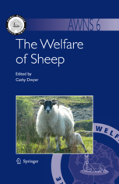
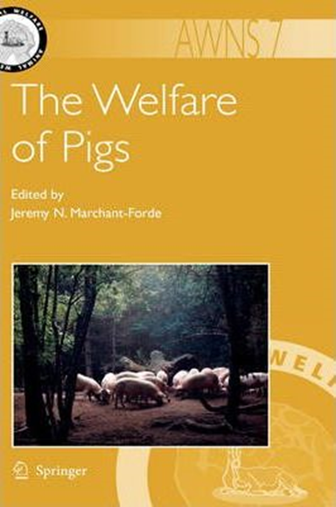
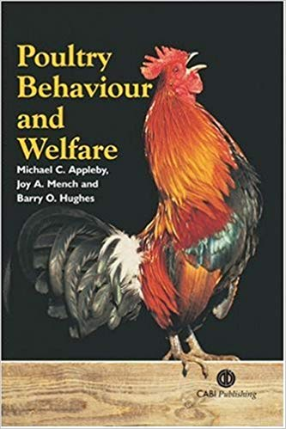

Notes:
Celkem tedy = 2434 stran ☺

Slide 8
Legislation regulating farm animal welfare
208/2004 Czech decree on Minimum standards for the protection of farm animals​
246/1992 the Czech National Council on the Protection of Animals Against Cruelty (e.g. transport)​
COUNCIL DIRECTIVE 98/58/EC concerning the protection of animals kept for farming purposes​
COUNCIL DIRECTIVE 2008/119/EC laying down minimum standards for the protection of calves​
COUNCIL DIRECTIVE 2007/43/EC laying down minimum rules for the protection of chickens kept for meat production​
Council Regulation 1099/2009/EC on the protection of animals at the time of killing​
Council Regulation (EC) No 1/2005/EC on the protection of animals during transport​

Slide 9

Information and study materials
https://cit.vfu.cz/hzwelfare/

Slide 10

Credit requirements
Full attendance (1 excuse possible)
Activity during practicals
3 tasks:
  2 presentations
  1 essay
Notes:
Practacals are oblikatory

Slide 11

1. Presentation
Weeks 2-7
Characteristics of the assigned species
Decree No. 208/2004 Coll. – Minimum standards for the protection of livestock
Elaborate on the minimum standards for the assigned species
Provide explanations, examples, and photos

Slide 12
Topic of week 8: Welfare during transport, markets, exhibition
  Council Regulation (EC) No 1/2005/EC on the protection of animals during transport
  Other thesis obout welfare during markets, exhibition
Topic of week 9: Welfare during stunning and slaughter
  Council Regulation (EC) No 1099/2009 on the protection of animals at the time of killing
  Other thesis about private slaughter in your country or ritual slaugther (= without stunning)

Slide 13
Presentation schedule
Week of semmester | Date | Topic | Student
Week 2 | 25. 2. 2025 | Free week – Self-study
Week 3 | 4. 3. 2025 | Cattle (dairy, beef) | Nicol
Week 4 | 11. 3. 2025 | Pigs | Bozhidara
Week 5 | 18. 3. 2025 | Sheep and goats | Oona
Week 6 | 25. 3. 2025 | Poultry (broilers, laying hens) | Estíbaliz
Week 7 | 1. 4. 2025 | Ducks, geese and turkeys | Julia
Week 8 | 8. 4. 2025 | Transport, market and exhibition | Bozhidara, Oona
Week 9 | 15.4.2025 | Slaughtering | Nicol, Julia, Estíbaliz

Slide 14
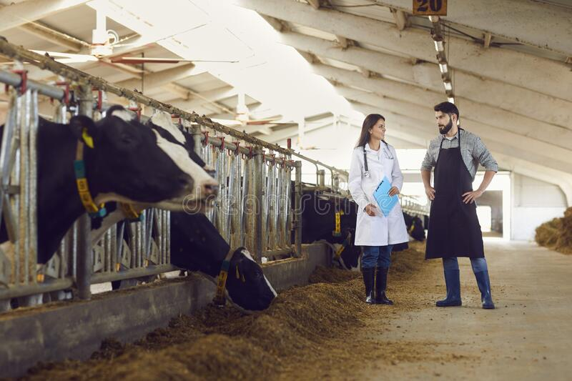
Animals welfare control in the Czech republic
State Veterinary Administration (SVA) controls the welfare status of livestock farm. SVA does not use assessment protocols
Legislative requirements
Essential for livestock is degree 208/2004 - Decree on minimum standards for the protection of farm animals​
An administrative infraction may be penalised

Slide 15
Minimal standards - summary
Concepts (Definition)
Minimum standards for livestock facilities
Generaly requirements for the keeping of livestock
Minimum standards for individual kind of farming animals and category
Notes:
Your task for the next practical will be to prepare for the cattle

Slide 16
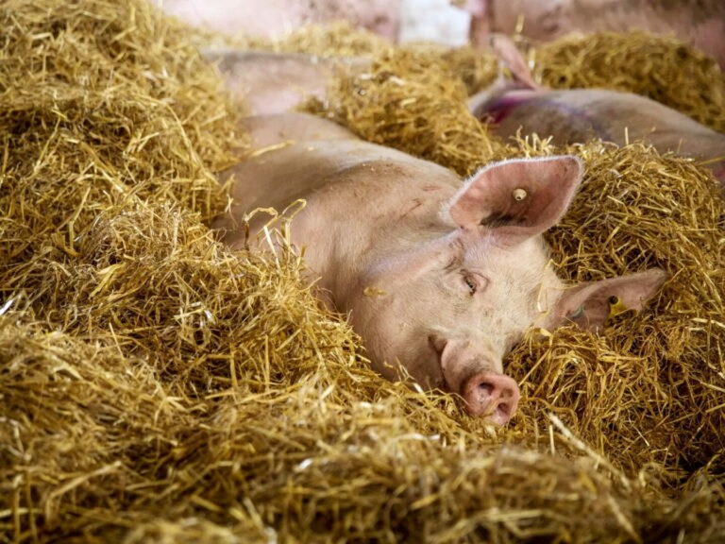
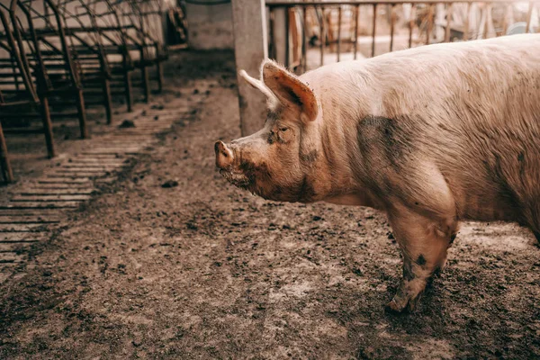
Minimum standards for livestock facilities
Stables are facilities for the housing of livestock
Stables must be designed to ensure proper air circulation, with controlled levels of dust, temperature, relative humidity, gas concentrations, lighting, and noise, all kept within limits that do not harm the animals.
Climatic condition are better

Slide 17
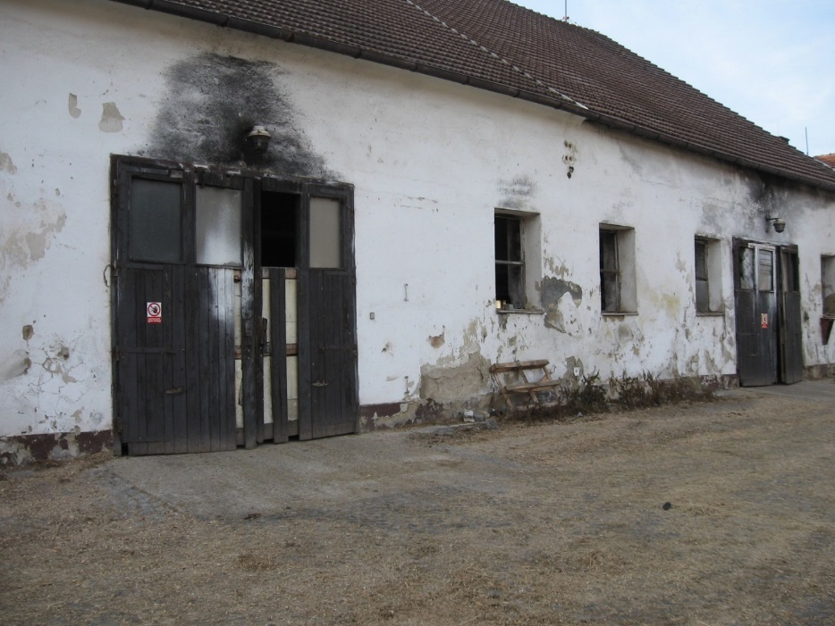
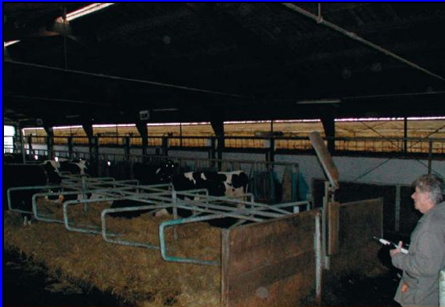
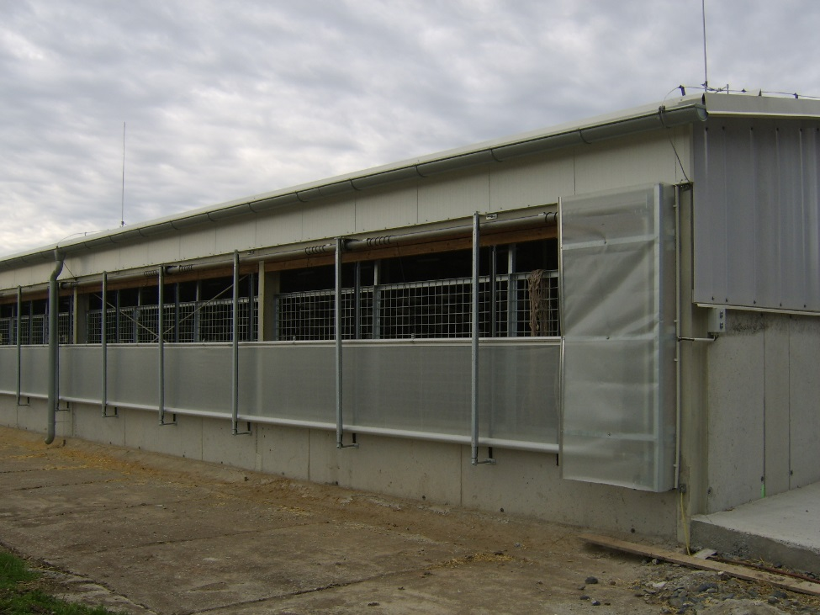
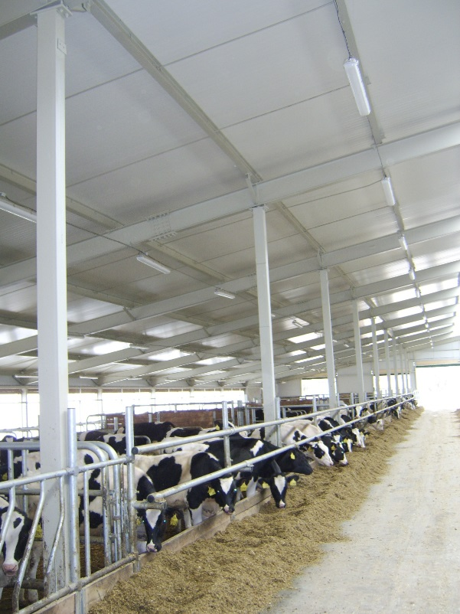
Lighting is not sufficient during the day.
Is the ventilation effective?
Light, clean and airy area

Slide 18
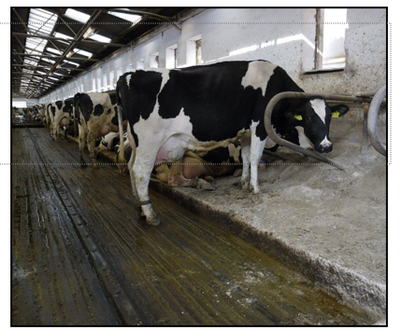
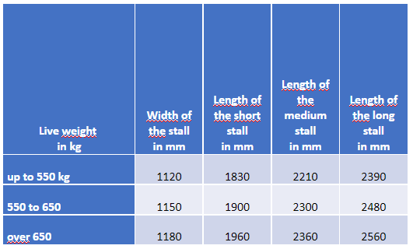
Cows - minimum stall dimensions​
(Annex 1)​

Slide 19

2. Practical lecture at the school farm in Nový Jičín
Assignment:
Write a document focusing on the knowledge gained during the farm visit
Choose one category and describe:
  Animals, biological characteristics, health and care, housing, nutrition, hygiene, etc.
Conclusion: pros and cons, suggestions for improvement, rule violations(?)
Send to my email (as soon as possible)

Slide 20
3. Presentation of a semestral work:
Evaluation of the level of welfare of livestock in the (private) small farm
Assignment:
Visit another farm (equestrian club, zoo farm, mini zoo – e.g. www.lamacentrum.cz, www.navylet.cz/cs/cil/mini-zoo-jizansky-dvorek)
Choose an assessment method (5 Freedoms, WQ, AWIN, Assure Welfare, etc.)
Use relevant indicators for evaluation
Create your own scoring/grading system
Presentation:
Information about the animals and breeds
Chosen assessment method
Observations and evaluation
Conclusion
Deadline: Week 13 (or Week 14)
Notes:
Evaluation of these protocols is difficult. You can make up your own scoring/grading.

Slide 21
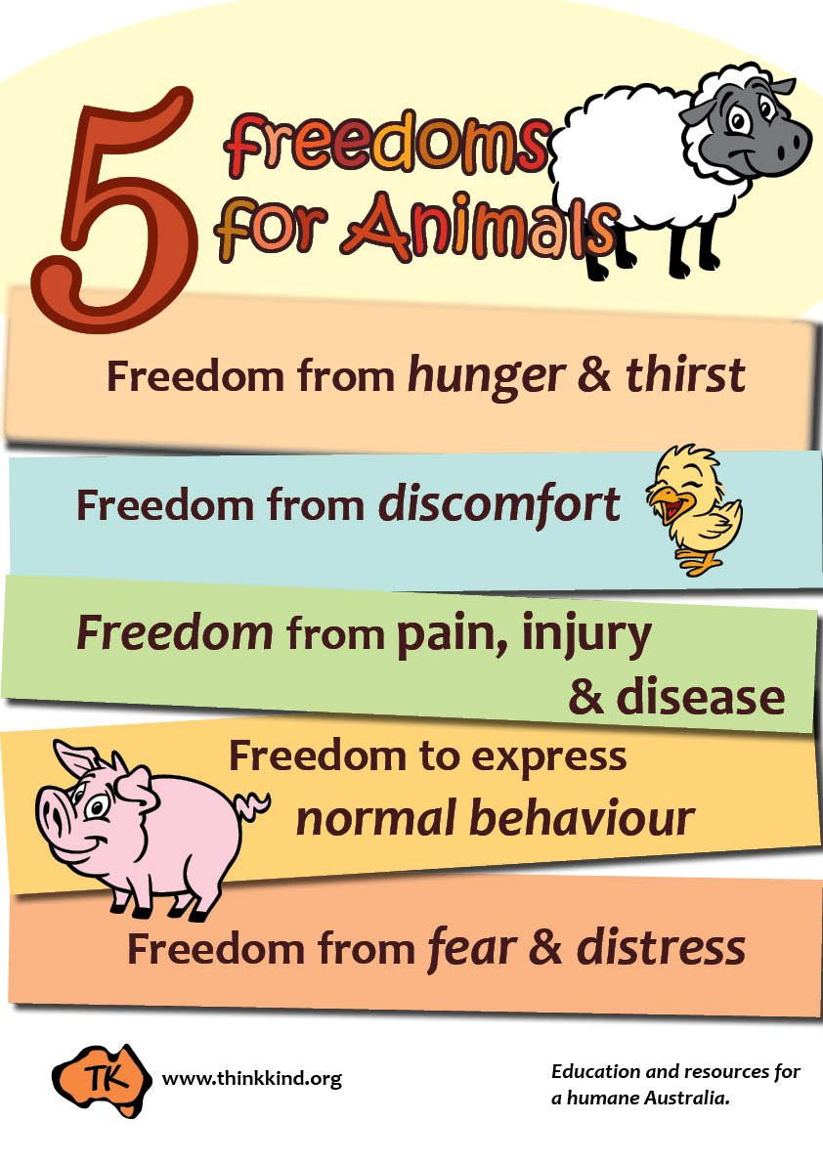
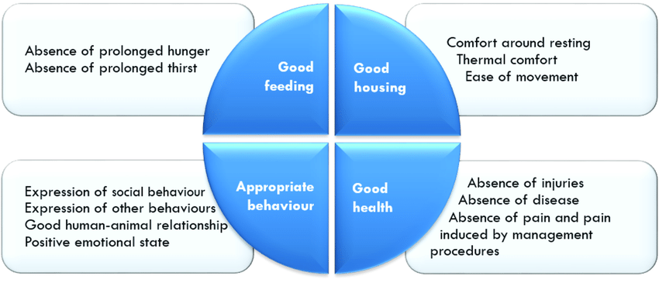
Assessment methods of animal welfare and indicators
Způsob hodnocení
Popis
AWIN protocol
You will talk about welfare assessment
methods in lectures​.
Notes:
If you know all the requirements for protection and wellbeing of animals you can evaluate its welfare according different methods

Slide 22
Next practicals
25.2.2025 – self-study
4.3.2025 - 1 presentation about dairy and beef cattle
  Characteristics
  Decree - Minimum standards for the protection of bovine animals
Principles of handling and handling of cattle (practical video demonstration)
The most common problems in cattle welfare
Model examples (we use the degree, you may bring copy or you can use your tablet)

Slide 23
Thank you for your attention.

