Slide 1
Pigs breeding and welfare

Slide 2
Reasons for breading of pigs
Meat
Skin – leather products
Bristles hair brushes, paint brushes
Works - Truffle search (France)
(Manure)

Slide 3
Domestication
Modern agricultural pigs have descended from the European wild boar (Sus scrofa)
Pigs were first domesticated in the Near East around 8500 BC and subsequently brought into Europe.
Domestication of the pigs was favoured by its social nature, adaptability and omnivorous habbits.
Their basic behavioural instinct have been conserved.

Slide 4
Technology of pig breeding
Rearing of gilts, dry sows, pregnant sows.
Female pig from the perinatal period until weaning of the young (farrowing house).
Rearing of piglets.
Fattening of slaughter pigs.
Breeding of breeding boars.

Slide 5
Gilts and sows breeding
First estrus - it is not advisable for insemination (mating).
Estrus recurs after 21 days.
Gilts are included in the breeding on the basis of selection.( Requirements: age 7 - 8 months and weight of 130 - 140 kg, good body confirmation, estral cycle, the number of teats on the left and right side is ideally 7/7).
Gilt The optimum period for insemination of gilt is at the 2nd to 3rd estrus. Sows are inseminated 10 days after weaning.
Flushing- The sow's diet is increased by 50 – 100 % 10 days before insemination. Flushing improve estrus symptoms and releases more eggs.

Slide 6
BCS
Determining the size of finisher pigs, replacement gilts and sows | ontario.ca

Slide 7
Estrus is characterized by behavioral and physical changes - restlessness of the animals, aversion to eat, vocalizing, harassment of other animals - attempts to jump, external genital organs and mucous membranes of the vagina are reddened and sweeling, vaginal discharge…

Slide 8
Management of the gilt for breeding and in first gestation for longevity (nationalhogfarmer.com)

Slide 9
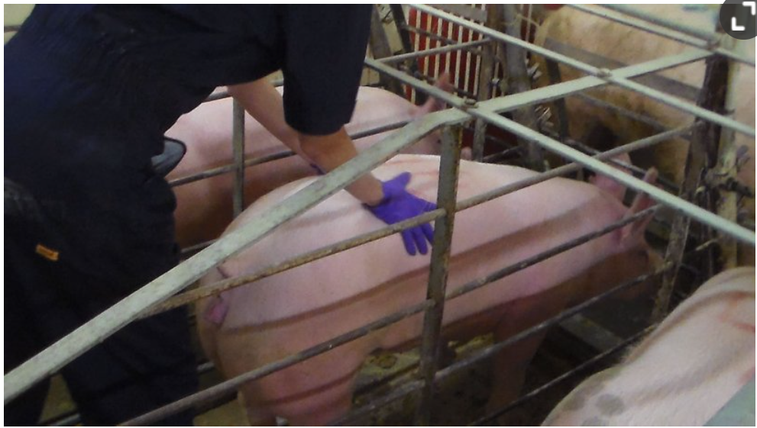
It is important for breeders to detect the reflex of immobility during estrus - it is manifested by a rigid posture, a characteristic sign of the period of receptivity to mating. It can be tested also by boar who walks along the corridor between the housed sows twice a day after feeding, morning and evening for half an hour. A boar older than 10 months, which has already produced enough pheromone substance which stimulates estrus in sows. It's in the boar's saliva and urine. The touch test is only used in herds with small numbers of sows.
The farmer pushes on the sow's back with both hands or by sitting on her back.
Practical tips to induce heat in gilts and sows - Articles - pig333, pig to pork community

Slide 10
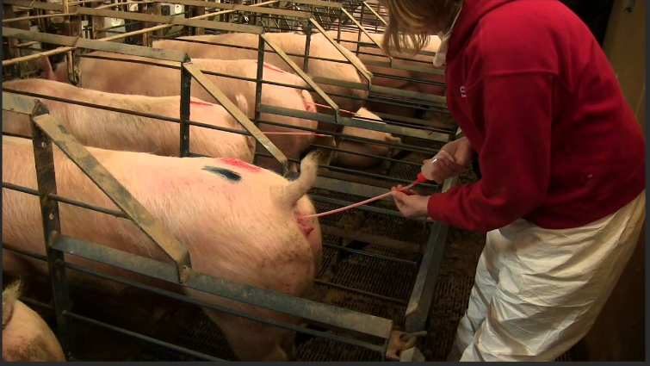
The insemination is performed in 10 to 12 hours after the reflex of immobility is detected, and reinsemination is carried out in a further 10-12 hours.
Post-Cervical Artificial Insemination in Sows AS-623-WV - YouTube

Slide 11
Detection of pregnancy
Laboratory method is determination of the concentration of the hormone progesterone on days 17 - 21 ( Expensive)
Ultrasonography is performed from day 23. Ultrasound examination of sows is performed through the abdominal wall in the region of the groin, simply by placing the probe.
Another estrus will not occur in a pregnant female.
Pregnancy is repeatedly checked.
Breeder can monitoring of external signs of abdominal distension in the higher stage of pregnancy.

Slide 12
Ultrasounding for Pregnancy Detection - Pork Information Gateway (porkgateway.org)

Slide 13
Pregnancy in sows lasts 115 days.
In the conditions of large farms, farrowing takes place in individual farrowing pens.
Pregnant gilts and sows are washed a moved to the farrowing section a week before farrowing.

Slide 14
Sow housing technology
It is one of the most demanding technological systems in pigs breeding.
Successful breeding results are determined by:
the number of piglets reared per sow per year (Minimally 22 piglets reared per sow/year. Is required 2.2 - 2.4 litters per sow per year.)
their weaning weight
piglet balance and piglet vitality

Slide 15
Sow housing technology
Categories:
Sows not inseminated, in the period of insemination and early pregnant,
Pregnant sows (pregnant to about day 108 of gestation),
Pre-parturition, farrowing and lactating sows (7 days before farrowing and from farrowing to weaning of piglets).

Slide 16
Housing
Individual boxes - this system is preferred especially in large farms where sow insemination is used.
Ind. housing covers the period from the beginning of estrus to the detection of pregnancy
The advantages of housing are a better overview of animal behaviour, feed intake, health and care.
Disadvantages - poorer estrus display and recognition, more labour intensive, sows have limited exercise during the period of insemination until pregnancy

Slide 17
Box pens
It is a combination of group and individual housing. Each sow has her own individual stall with the possibility of fixation, behind which there is a common area.

Slide 18
Sows are group housed and they can move until estrus.
The sows are fixed in individual crates from the beginning of estrus.
They are kept here until pregnancy is established.
The box pen is opened and they are allowed to move freely again.

Slide 19
Group housing
There are usually 6 - 8 sows of the same age and approximately the same weight and in the same stage of pregnancy in one pen
Advantage:
Better stimulation and more pronounced estrus.
Intolerant sows must not be kept with others in a group!
Sows can be reared in traditional technologies on bedding, on deep bedding or without bedding (slatted floors).

Slide 20
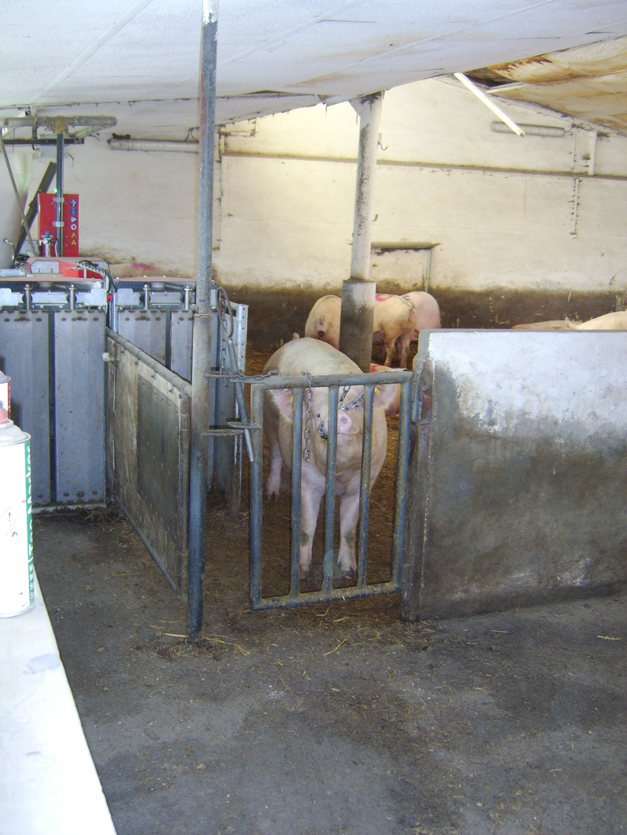

Slide 21
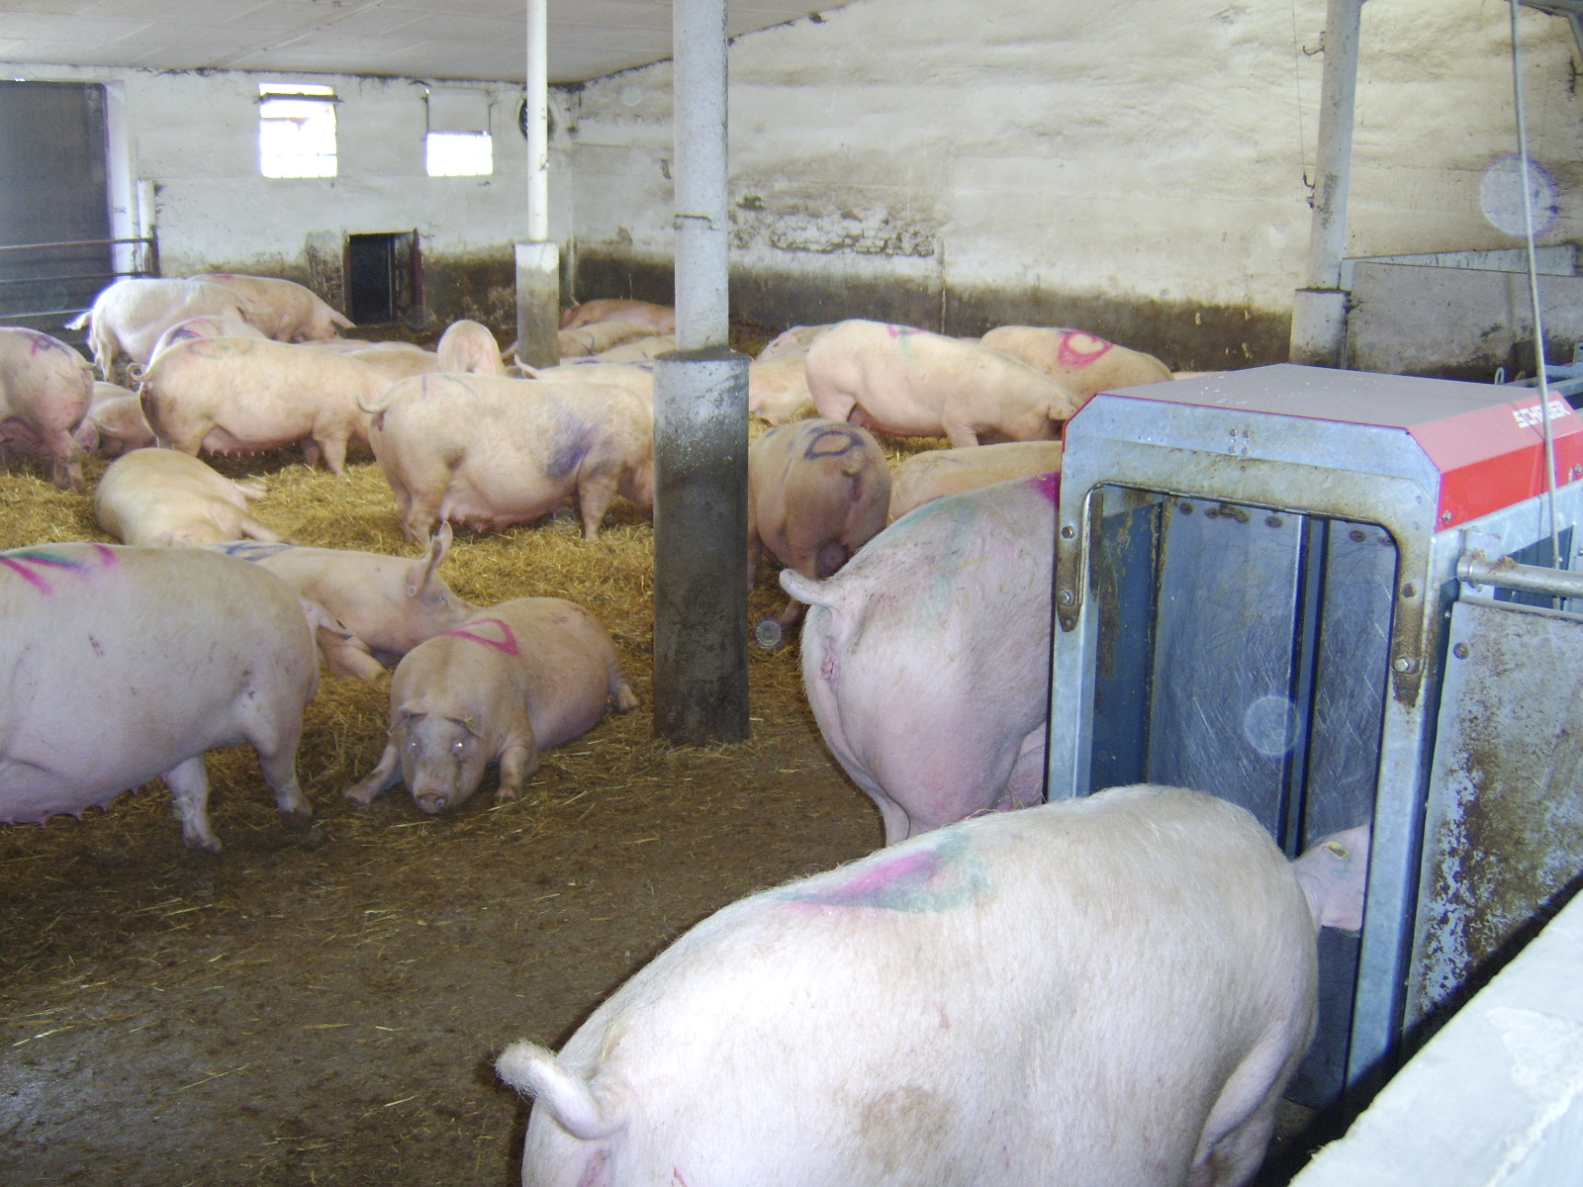

Slide 23
Housing for pregnant, lactating and farrowing sows (farrowing house)
Individual housing is used. Sows are transferred to an individual pen 7-10 days before farrowing, where their movement is limited by restraints.
Purpose:
Significant reduction of piglet losses by sow.
The floor is fully or partially slatted, mostly without bedding. The pen equipment includes a trough and drinkers for the sow, a drop feeder, a drinkers and a burrow for the piglets.
The farrowing house is air-conditioned with a temperature of 21-22ºC and a relative humidity of 75 %.
After weaning, the piglets are moved to the finishing room and the sows to the "farrowing room" where they await insemination.

Slide 24
Clean farrowings crate are prepared for pregnant sows.

Slide 26
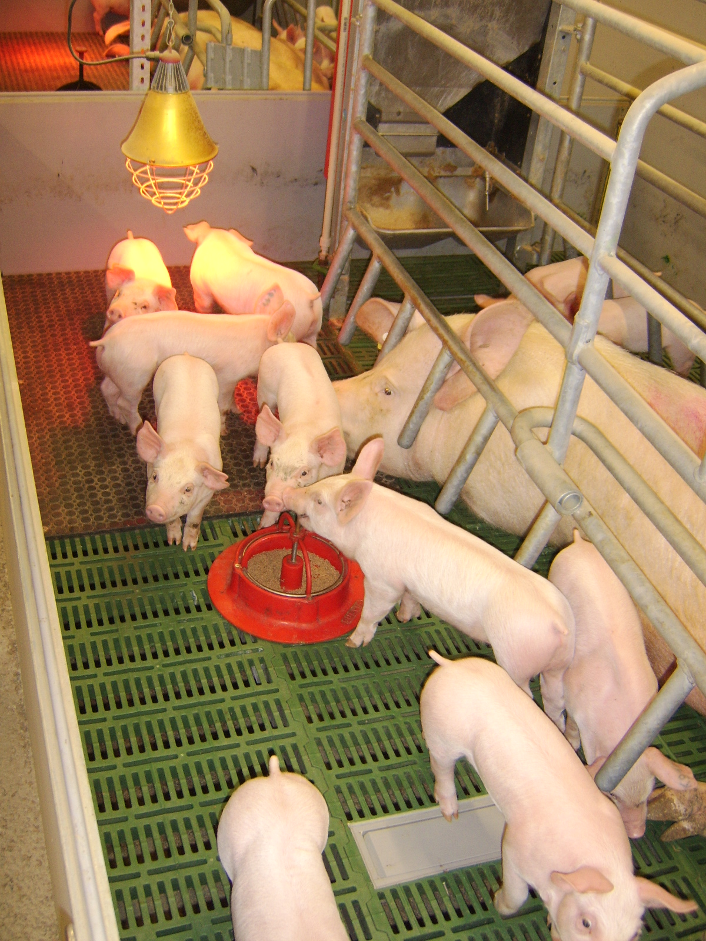
Sows in farrowing crate
with piglets.

Slide 27
Signs of impending parturition:
Characteristic weakness of the pelvic ligaments, the external parts of the genital tract become enlarged and vascularized, the sow is restless, frequently urinates and defecates, gets up and lies down.
The sow is not fed on the day of birth and must have access to water.
The feed ration is reduced according to the scheme 3- 2 -1- 0
3 days before birth the feed ration is reduced by a quarter, two days before birth by half and the day before birth by ¾.

Slide 28
Treatment of piglets after birth
Breeder checks pregnant gilt/sows before and during birth.
Assistence is not required.
But:
If the piglet in the amniotic sac, remove it
You have to clean the oral cavity and nostrils
Umbilical cord is usually breaks, desinfect them
You can attach the pig to the mammary gland.
The piglets do not have developed thermoregulation after birth, so they need to be moved to a room where the temperature is 32-35 oC, the piglet room is heated either by electrically heating plates or infrared heaters, e.g. infralamp. Thermoregulation is developed at 21 days of age.

Slide 29
Piglets that weigh less than 1 kg at birth are problematic. If they are not given extra care - they starve to death. The optimum weight of a live-born piglet should be 1,3-1,6 kg.
Newborn piglets are looking for a mammary gland. The first piglets drink during birth.
Piglets from multiple litters can be removed from the sow and added to a sow with a less numerous litter.
During the first days:
The breeder or vet technician can pinching or grinding sharp teeth. They can use the emasculator and dock the tail.(Legislative requirement -only for therapeutic reasons)
They castrate the males.
Piglets receive pellets from 5 days of age.

Slide 30
Methods of weaning piglets
Weaning a piglet can be done at any age – in the earlier weaning we have to provide the better the conditions!
traditional weaning - 56 days
Shortened weaning - 49 days
early weaning - 11-21-28 days max. up to 35 days
early weaning - 36-48 hours or 4-10 days
Artificial weaning - SPF weaning (caesarean section or hysterectomy - remove the uterus - piglets in an incubator, during recovery actions).

Slide 31
Housing systems
Weaned piglets are moved from farrowing houses.
Weaners, growers and finishers are bred in a stable groups.
The most common method of housing is the litterless housing with plastic slats but housing on deep bedding can be used too.
The optimum number of pigs in litterless housing is 10-20 piglets in and 30-40 piglets in deepbedding.

Slide 32
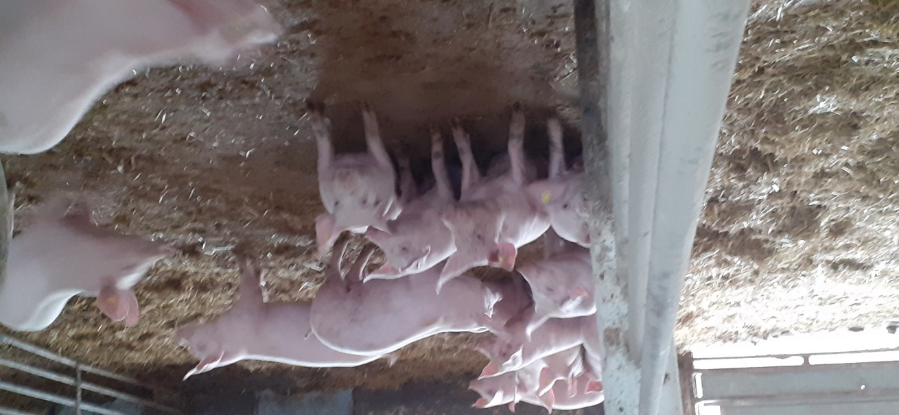

Slide 33
Feeding
The fattening is carried out on the basis of complete feed mixtures A1 up to 35 kg, A2 for the weight category up to 65 kg and CDP (cereal pig diet) is fed until the end of fattening.
Weaners and growers are feed at libitum. Finishers (65kg +) are fed 2 – 4 times during day.
The feed mixtures are given in wet or dry consistency.
Drinking water is provided by automatic waterers.

Slide 34
Breeding of boars
Breeding boars are used either in natural breeding or at insemination stations. Currently only 1/3 of the piglets are born after natural breeding. Selection of boars for breeding - based on temperament, libido, fundament and testicular development. Breeding boars are quarantined for 28 days. During this period, health tests are carried out, the phantom is habituated, semen is collected and assessed.

Slide 35
Housing system
Boars are housed in window stalls, individual pens with the possibility of movement in the enclosure. An area of 6 m² is required. Movement and cleanliness of the boar is beneficial to its health, and it is recommended that boars be exercised every other day. Dry brushing and showering are used in the routine grooming of boars.
A boar should have a constant handler, as turnover is negative for the boar's behaviour. Handling must be firm, kind and careful, and the boar must respect the handler.

Slide 36
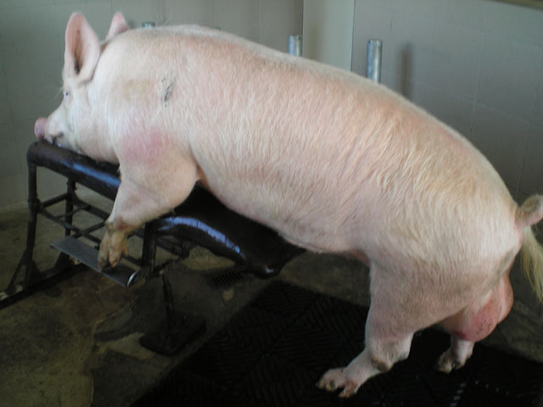
https://web2.mendelu.cz/af_291_projekty2/vseo/print.php?page=511&typ=html

Slide 37
Production indicators of a thriving business
Raised 22 piglets per sow/year
Sow longevity - 6 litters from 1 sow
2.2 - 2.4 litters per sow/year
Minimum fattening gain 800g/head/day
Feed conversion per kg gain up to 3.2 kg
Maximum slaughter weight 105-108 kg
Fattening time from birth to slaughter weight up to 175 days

Slide 38
Outdoor pig production systems
High level of animal welfare.
Negatives - piglet mortality may be higher, exposure of animals to extreme weather.
Positives - plenty of space, expression of natural behaviour, individual shelter for piglets, shelter from bad weather, breeds resistant to these conditions used, advantage lower percentage of overliing piglets better sows health, advantage of absence of hard floor.

Slide 39
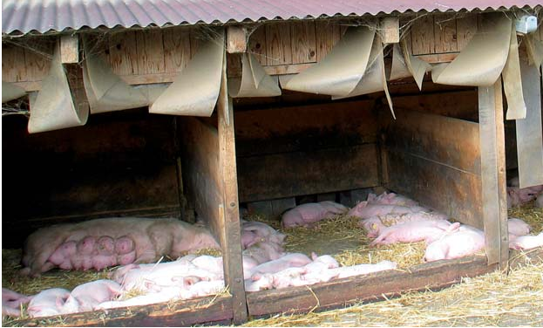
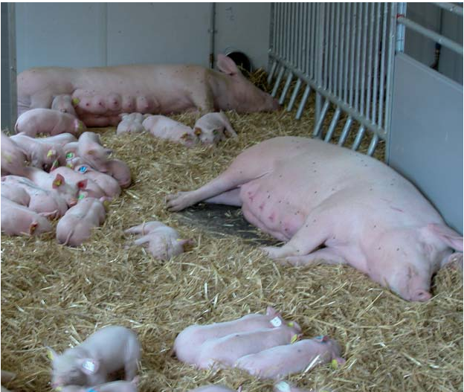
Housing for pregnant, lactating and farrowing sows (farrowing house)
Group suckling of piglets in organic pig farming
New system combined individual and group breeding
Sow gives birth to piglets in a pen. They are in this pen for 14 days. The side walls of the pen are removed. A sow with piglets lives in a group.
Skupinové kojení selat v ekologickém chovu prasat (orgprints.org)

Slide 40
Outdoor pig rearing system
They have the greatest potential for ensuring good welfare of growing pigs. There are many opportunities for natural feeding behaviour.
Housing density is lower, reducing the risk of aggression.
Subordinate pigs can easily escape from aggressive conflicts.
There is no need to change the composition of the groups as the animals grow.
Better gain and lower mortality – the result of reduced stress.
The pigs spend hours here.

Slide 41
Pigs health
Health is an important aspect of welfare.
Breeders follow the basics of biosecurity.
Measures to reduce the contamination of stables –
closed herd turnover, turn-over technology, adequate density of animals, cleaning and disinfection of stables, adequate ventilation...

Slide 42
Parasitoses
Parasitoses are one of the most widespread diseases in pig farms. Parasitoses do not cause mortality or significant disease, but have a major impact on the performance of pigs.
Parasitoses – internal and external
The most important are the intestinal.

Slide 43
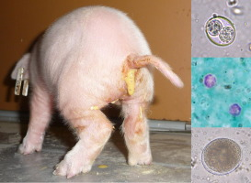
Coccidiosis
caused by unicellular parasites of the genera Isospora and Eimeria. They cause infection and destruction of the intestinal mucosa. The disease is manifested by severe diarrhoea in piglets aged 5-15 days.
https://www.sciencedirect.com/science/article/pii/S1383576916302276

Slide 44
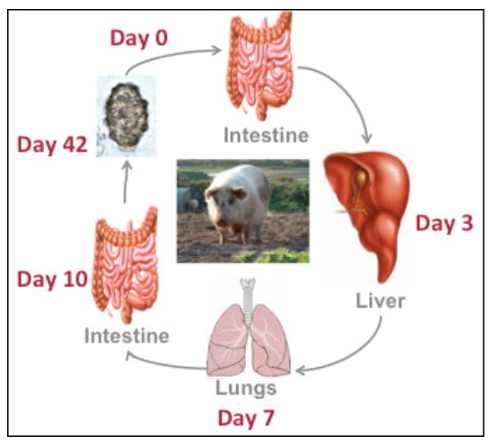
Roundworm
The roundworm eggs are swallowed. The larvae are released from the eggs in the intestine. These invasive larvae migrate to the organs. The adult roundworms mechanically irritate the lining of the intestine. They take nutrients from the intestinal contents and blood from the intestinal wall.
Ascaris suum infections | Laboratory of Parasitology (ugent.be)

Slide 45
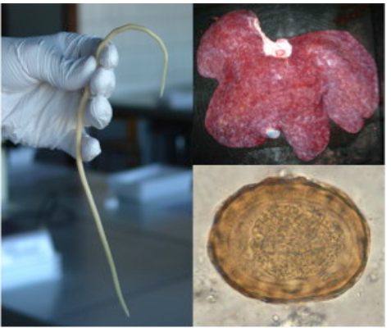
Symptoms : Anorexia, anaemia, loss of condition. Weight loss in later stages.
Ascaris suum infections | Laboratory of Parasitology (ugent.be)
When the worms die suddenly after treatment, they can block
the gut and cause sudden death.

Slide 46
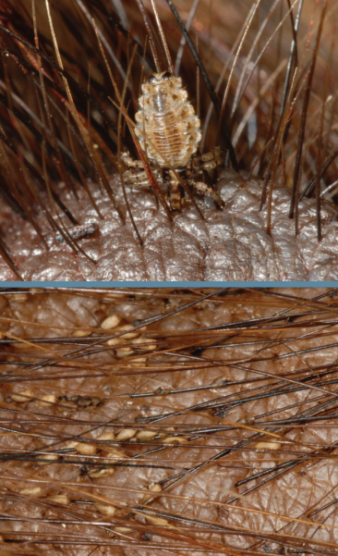
External parasites
mainly include lice, mange and myiasis
Lice
Haematopinus suis, the hog louse.
Is the largest louse species (6,4mm)
is more common in smaller populations than in commercial pig breeding. It is found in the folds of skin behind the ears and between the legs. The blood-sucking activity of hog lice results in much irritation and discomfort to swine. Skin may show red spots or bite wounds. Extreme pruritus and subsequent self-trauma (alopecia, erythema, excoriations, and crusting) can be seen.
It can cause severe anemia, especially in piglets.
swine-ectoparasites-hog-louse1.pdf (porkgateway.org)

Slide 47
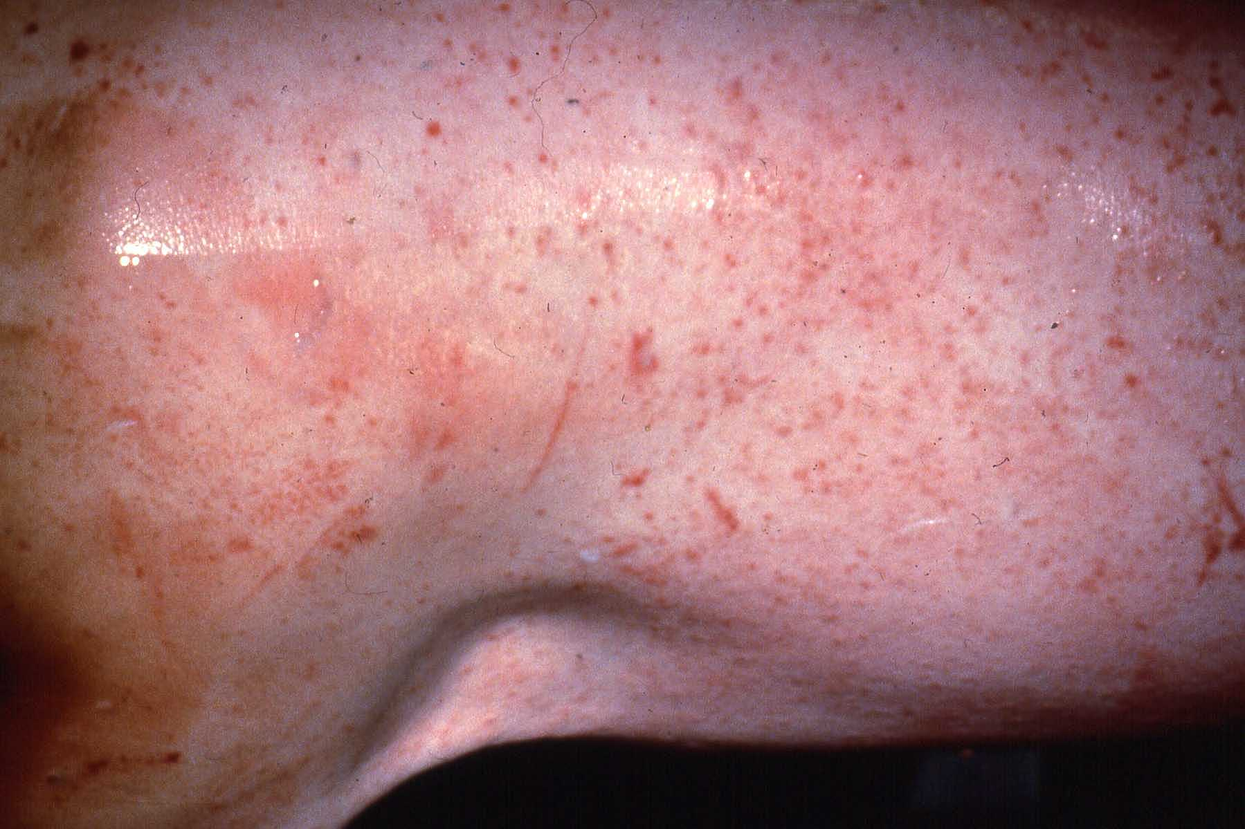
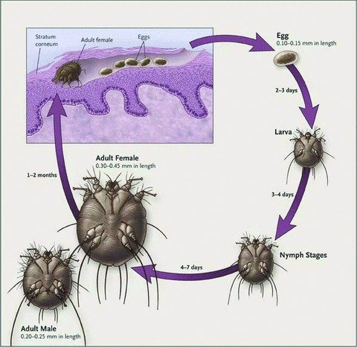
Mange
in pigs is principally due to infestation with Sarcoptes scabieisuis.
Transmission of S. scabieisuis can occur rapidly via direct contact between pigs.
Mange live in the skin. It feeds on skin cells and their tissue fluid. They provoke severe itching and irritation.
Lesions may start on the head, around the eyes, nose, or ears; Lesions may progress to hyperkeratosis and exfoliation of epidermal debris.
NADIS - National Animal Disease Information Service
Scabies in animals and humans: history, evolutionary perspectives, and modern clinical management (researchgate.net)

Slide 48
Myiasis
Myiasis is the infestation of living vertebrates with the larvae of flies, which lay eggs in the wounds. The eggs hatch into larvae. The larvae must feed on the tissues of affected animals, sometimes causing serious clinical problems, and even death.
------
The deworming schedule should include prebreeding for all breeding stock and prefarrowing for gilts and sows, prevention of Strongyloides and roundworms in baby pigs, and one or more dewormings in weanling and growing pigs.

Slide 49
Reproductive Disorders and Diseases
Brucellosis
Brucellosis in pigs is a contagious disease of domestic and wild pigs, which is manifested by reduced fertility in boars and sows.
caused by bacteria Brucella suis, dangerous disease
Symptoms
Symptoms are pronounced at the first encounter with the infection.
Severe symptoms are anorexia, fever, stiff legs, occasional lameness, early abortion. Infection later in pregnancy gives rise to litter with mummified, still born or weak piglets.
Boars usually develop orchitis (inflammation of one or both testicles) and epididymitis within seven days of infection.
The testicles are swollen and painful and permanent sterility can be the result.
If the infection has been in the breed for a long time the clinical signs are mild. The fertility of sows is lower and the number of piglets in the litter is lower.
Mastitis
Bacterial infection causes an inflammation of the mammary organ and results in changes in milk production. These bacteria enter the wounds in the udder.

Slide 50
Parvovirosis
a viral disease found in most farms.
Does not cause clinical signs in sows.
Fertility disorders ( as infection of embryos, mummification of fetuses, birth of short-lived piglets ) occur in pregnant sows.
Porcine reproductive and respiratory syndrome (PRRS)
is a widespread viral disease that affects domestic pigs. Symptoms include reproductive failure (fetuses are fully developed), a breathing problem causes blue discoloration of the ears, snout or abdomen. Pneumonia and increased susceptibility to secondary bacterial infection.

Slide 51
Respiratory diseases
PRRS
Atrophic rhinitis
Chronic bacterial disease of the upper respiratory tract.The bones and cartilaginous structures in the nose change shape. Signs are sneezing and runny nose.
Other respiratory diseases are enzootic pneumonia and actinobacillus pleuroplneumonia.

Slide 52
Gastrontestinal tract diseases
Coli infection
The level of immunity affects the course
Escherichia coli is commensal intestinal mucosa or pathogen. Pathogenicity is dependent on virulence factors. The level of immunity affects the course.
Transmission by ingestion of contaminated feed (orofecally). Symptoms are diarrhea or other (git disability, sudden death).
Salmonellosis
Causes acute or chronic disease. The disease can occur as an involvement of the digestive tract or septicemia

Slide 53
Disease Causing Problems in Walking
Arthritis
Symptoms
Inflammation of joints. Joints are swollen.
Streptococcal infections Symptoms
Septicaemia (blood poisoning) which may cause immediate death.
Young pigs rarely recover
Sudden death in older pigs.
Fever, nervous signs and arthritis mostly in weaners and fatteners.

Slide 54
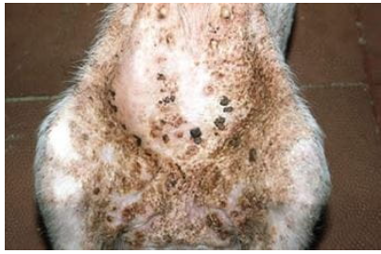
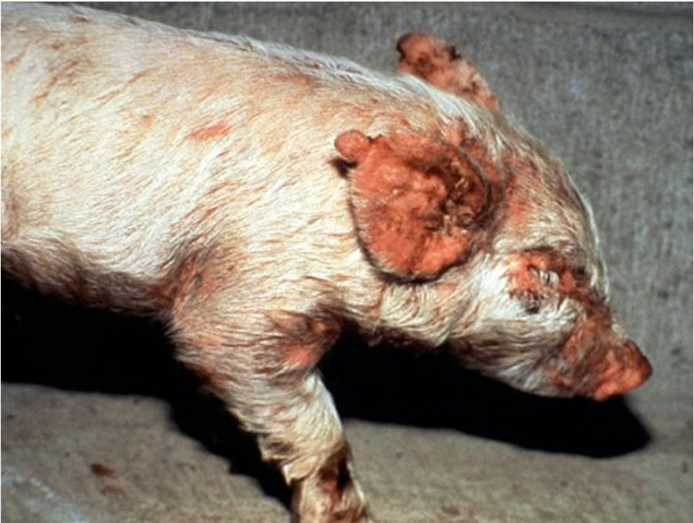
Skin disease
Exudative epidermitis (EE), commonly known as “greasy pig disease” is a generalized or localized skin disease of piglets characterized by exfoliation, sebaceous exudation, and formation of a crust that may cover the entire body.
staphylococcal infection
Exudative Epidermitis in Pigs - Integumentary System - MSD Veterinary Manual (msdvetmanual.com)

Slide 55
Welfare issues
Agressive bahaviour
The reasons for it
frequent regrouping of pigs into new pens with unfamiliar pigs.
hight density of pigs in the groups of growing pigs.
- lack of bedding.

Slide 56
Problem with legs
Concrete floor or slatted floor are used in intensive farming
Concrete floors can cause cuts and scratches on joints and limbs.
Laminitis and bursitis are often develops on the slatted floor (especially swelling of the knee joint).
These problems are not visible in bedding system with straw.

Slide 57
Other welfare problems
painful tasks in pigs
Farrowing pens
Hight reproductive intensity and exhaustion of females

Slide 58
Tail biting - one of the biggest problems of welfare!
Multifactorial problem
It is necessary to separate the victim and the attacker.
Evidence indicates that tail-biting pigs are likely to be frustrated.
According to European Food Safety Authority, the most important risk factor for an outbreak of tail biting is the lack of straw or other environmental enrichment in intensive systems.
Ather risk factors are unsuitable microclimate, high stocking density and large herd, gastrointestinal discomfort, poor health status, suboptimal or imbalanced diet, individual factors (some genetic lines have a tendency to tail chew)
Tail biting should be prevented by stimulating exploratory behaviour towards manipulable substrate
Tail docking tends to reduce the incidence of bitten tails under controlled conditions, but does not eliminate the abnormal behaviour.
Tail docking is still considered a routine management procedure on intensive farms to prevent tail biting.

Slide 59
Stable microclimate
In our conditions, animals are kept in closed object for their entire lives. From the point of view of microclimate, pigs are among the most demanding farm animals.
A direct correlation has been shown between the high percentage of stillborn piglets, mortality losses at lactation and weaning, low gains and mortality and the amount of slaughter required in fattening and unfavourable microclimatic conditions in the stall.

Slide 60
Factors
Temperature, relative humidity and air circulation are the most important. When these factors change suddenly, the organism reacts with physicochemical thermoregulatory mechanisms that maintain a constant body temperature.
It primarily attempts to maintain a constant body temperature by engaging physical regulation, primarily by limiting heat output at low temperatures and by evaporation (direct evaporation from the body surface or lungs) at high temperatures. If this is not enough, chemical regulation is used. When temperatures fall or rise above and below the established limits, it means poored nutrient conversion due to cold or heat stress.

Slide 61
Temperature
The air temperature is important, but important is also temperature of floors and surfaces. Ideally, the amount of heat transferred should be equal to the amount of heat produced by the organism without the need to engage thermoregulatory mechanisms.
Low temperatures in the stall in winter increase feed intake and, conversely, higher temperatures in summer reduce consumption and lack of appetite due to reduced metabolism.

Slide 62
Relative humidity
It is always assessed in relation to temperature. The humidity of the air affects the heat output of the body. In unheated stables there are problems with high humidity in winter due to insufficient air exchange. High humidity directly accelerates heat expenditure in animals at low temperatures. In contrast, in heated stables there are problems with low humidity, which decreases with increasing temperature - increased dustiness, drying of mucous membranes, disruption of the body's protective barriers and increased susceptibility to infection. High humidity and temperature lead to the inhibition of heat transfer by evaporation and overheating of the organism.
Clinically healthy pigs can tolerate a cool and dry environment without major problems for a temporary period.

Slide 63
Air flow rate
At low temperatures, the airflow accelerates the heat output. Therefore, at optimum temperatures, an airflow of 0.1-0.3 m/s is required, at low temperatures the airflow must be reduced. At high temperatures above the maximum, increasing the airflow (sow stalls and fattening pigs) is the only way to prevent overheating (0.5-1.5 m/s). Higher air flow has a negative effect on weaning piglets even at higher temperatures. In pig farming, the rule applies - drafts (one-way air flow) must be avoided - above 3 m/s. High air flow at low relative humidity also increases dustiness.

Slide 64
Stable lighting
Important not only for keeping the animals and equipment clean, but also for the physiological functions of the body. It is used in metabolism, affects the activity of the nervous system and blood composition...
It is necessary to ensure not only the length of the lighting, but also the intensity and uniformity of the lighting. Recommended light intensity in farrowing rooms 75 lx, in fattening 40 lx, for boars 100 lx. Recommended length of natural lighting – 14 hours, in windowless halls for pig fattening, regime 3 x 1.5 hours or 4 x 1 hour.

Slide 65
Noise
It affects the auditory and nervous organs, but also the whole organism. It is stressful when the maximum limit is exceeded - reduced performance and health problems depend not only on the noise level, but also on the frequency and duration of exposure and the immediate physiological state of the animals.

Slide 66
Stable gases
Carbon dioxide
It is an indicator of insufficient air exchange in the stable. It is produced as a product of respiration, fermentation in the digestive tract and litter maturation. The normal concentration ranges from 0.2-0.3 per cent by volume - concentrations of more than 10 per cent by volume have a negative effect on the organism.

Slide 67
Stable gases
The ammonia and sulphate content in the stall, which is produced by the degradation of organic nitrogenous substances in the stall, urine and excreta, also has a negative effect.
Their effect is particularly pronounced after prolonged exposure
These gases can increase susceptibility to infections
Elevated concentrations of ammonia and sulphate are indicative of the level of hygiene in the stable! Maximum concentrations in the stall
is 25 ppm for ammonia
is 10 ppm for sulphate

Slide 68
Dust and microbial contamination
Source - feed, bedding and animals.
Microorganisms are attached to dust particles or droplets.
Saprophytic mikroflora and pathogenic micro-organisms may be present in the stable and survive for a certain period of time.
The size of the particles is important factor. Particles larger than 5 μm are trapped by airway defence mechanisms, while smaller particles enter the airways..
Dust particles settle in the respiratory tract and skin of pigs and can complicate respiratory disease in finishing pigs and piglets.

Slide 69
The human factor and care
It is one of the crucial factors influencing animal welfare.
It depends on the professional level of the animal handlers, their feeling and relationship with the animals, their attitude to work and compliance with technological procedures.

Slide 70
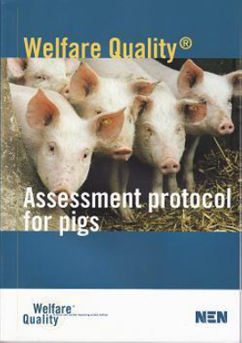
Assesment protocol for pigs
Welfare Quality protocols are aimed at assessing the welfare level of sows and piglets in farrowing and fattening pigs.
The protocol is based on 4 principles.

Slide 71
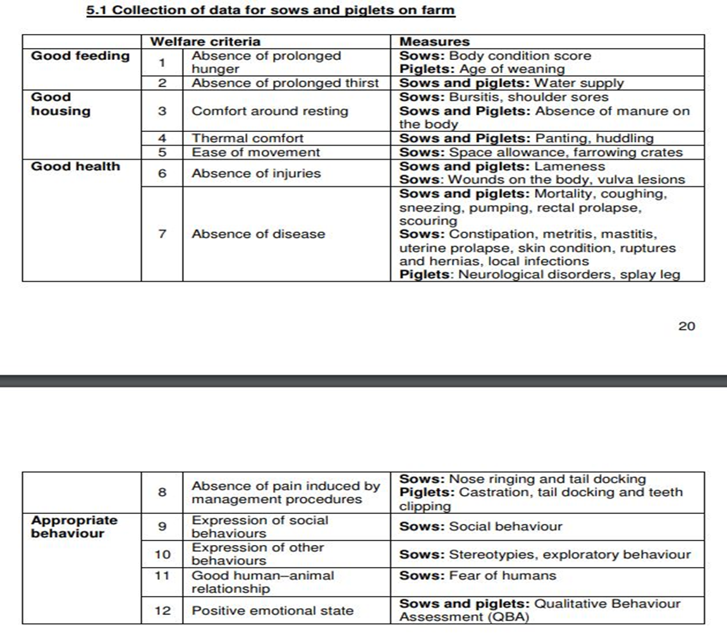

Slide 72
