Slide 1
Veterinary forensic investigation
This presentation is supported by VFU IVA project no. 2019FVHE/2380/63

Slide 2
The content of presentation
Forensic investigation
Primary crime scene analysis
Collection of evidence
Secondary crime scene analysis
Veterinary toxicology
DNA analysis

Slide 3
Forensic investigation
Investigations can generally be divided into primary and secondary crime scene analysis
Primary crime scene analysis - crime scene investigation, crime scene investigation, victims, recognition and evidence collection, photo documentation
Secondary crime scene analysis - takes place outside the crime scene, may include analysis of crime scene traces, laboratory techniques, necropsy and various

Slide 4
Role of an animal
Due to the investigation, the animal may be at the scene:
1. a victim - most often (violence, neglect, generally abuse)
2. a suspect - predator, dog attacks on man…
3. a witnesses - keeping physical evidence in hair, claws, mouth ...
The theory says that if a victim meets a suspect at the scene, and the witnesses leave a mark on each meeting, therefore, even without verbal communication, the animal can testify in the form of preserving physical evidence in the fur… (the body of the dog may be indicative of the presence of the dog at the site)

Slide 5
Primary crime scene analysis - crime scene investigation
Different types of crime scene, sometimes livestock, sometimes wild, sometimes pets
Sometimes the investigation takes place on the farm, sometimes at the owner's home, sometimes in the shelter
The investigator must have the experience to be able to identify possible evidence at any crime scene, be able to document, collect and transport

Slide 6
Crime Scene - First Steps of Investigation
The first person to arrive at the crime scene is likely to be a policeman or official veterinarian
He / she should assess the risk to himself / herself and other people or animals
He should write down the remarks he gives to the investigator: his name, office, date and time of reporting suspicion (a phone call from neighbors), time of arrival at the crime scene, outdoor conditions (weather at that time) and observation results - mainly transient events (the presence of wild animals at the crime scene, which at the time of the arrival of the investigators may no longer be at the scene, the sound of animals, the smell)
Any further investigation of the crime scene should be entrusted to specialists in order not to destroy the evidence

Slide 7
Crime Scene - First Steps of Investigation
After an assessment of the safety at the crime scene for the person calling the investigator, for other people, for animals, it is possible to request the arrival of the emergency services and private veterinarians at the crime scene
He should secure the crime scene until the official investigator arrives
The delimitation of the crime scene may be by means of tapes guarded by police officers, police cars, or the delimitation of the crime scene may be given by the nature of the crime scene (eg. apartment, residence, limited area)

Slide 8
Crime scene and zones

Slide 9
Crime Scene - First Steps of Investigation
Every time there is an animal or more animals in the crime scene, the crime scene can be very chaotic and will require some investigator skills
Nevertheless, the crime scene should not be viewed differently than the crime scene involving only humans
Procedures and methods of investigation in veterinary forensic science are taken from human forensic science and its investigation, extended by animal specificities
Whether it is a crime scene involving animals or humans, investigator protection comes first
Personal protective equipment such as gloves, masks, and protective clothing help to protect investigators at the scene

Slide 10
Zdroj: https://www.thegreatcoursesplus.com

Slide 11
Crime scene
Protective equipment also prevents contamination and degradation of evidence at the scene
It is also necessary to change the protective equipment depending on the manner and nature of the samples to be analyzed (eg. biological material, etc.)
Sometimes it is necessary to summon humane specialists or vice versa for veterinary forensic investigators to participate in the investigation of a crime committed against humans

Slide 12
Crime scene investigation
Zdroj: https://malcolmfairleycase.weebly.com/

Slide 13
Crime Scene - First Steps of Investigation
The investigator should establish the procedures and methodology of the investigation before entering the crime scene
Investigation methods should be as effective as possible and effectively document, collect and preserve evidence at the scene
The aim of the investigation methodology is to obtain the best evidence for later analysis
The model scheme of the procedure at the crime scene investigation is typically: clockwise, counter, grid, spiral
In the scheme, it is necessary to determine the start and end points of the crime scene

Slide 14
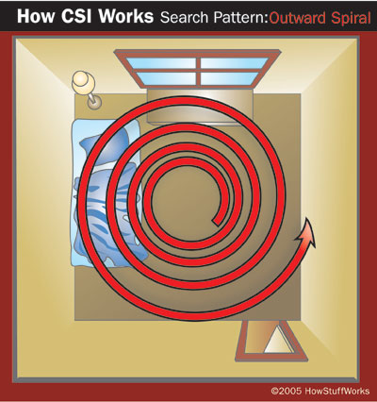
Scheme of investigation procedure
www.ukessays.com

Slide 15
Crime scene investigation
All of these procedures can normally be used at various crime scenes, but not at all
There are also less common practices, such as GPS coordination, which is better suited for large-scale crime scenes
The crime scene, which contains special evidence and traces, requires the investigator to choose an effective way of mapping the crime scene (for example, in the case of an animal injury that leaves blood traces, it is better to choose a tracking scheme that allows analysis around the traces left)

Slide 16
Crime scene investigation
Prior to the investigation, the investigator should assess the scene, the security, the content of the scene by going through the scene and noting everything he or she observes.
Everything is recorded and according to the notes will be chosen an effective way to investigate the crime scene
Notes may include: crime scene property, building, crime scene sides (sides may be marked by compass orientation or by the letters "A" on the front of the building and gradually along the sides to back)
A light source inspects the crime scene and the dark corners of the crime scene before investigating

Slide 17
Crime scene investigation
While browsing the scene, some signs of animal neglect (starvation, dehydration, drug problems, too small collars…) as well as other forms of animal cruelty, signs of attack or fighting between animals may be observed
Passing the crime scene should result in recording environmental conditions, availability of food, water, medicines and the presence of animal injuries
Evidence should also be recorded that could quickly perish or disappear (whine, lamentation of animals, odor, presence of other wild animals, etc.)

Slide 18
Crime scene investigation
Further evidence must be documented with photographs or video from the crime scene
At the same time, ensure witnesses, suspects or victims, if possible
Examples of the most common evidence at the scene:
firearms, knives, body scratches, body wounds, prescription medications, medical reports, medication prescriptions, excessive money at crime scene, presence of body fluids on walls or floor, presence of flammable substances, fingerprints, shoe prints, animal footprints …
After examining the scene, the investigator may reconsider the investigation procedure
Everything should be documented

Slide 19
Documentation on crime scene
Comments/notes
Photo
Video
Draw / diagram

Slide 20
Documentation - notes
Notes can be simple or detailed if necessary
Handwritten or completed in a pre-printed form
Basic notes of each investigation:
Date and time of notification
Identification of the notifier and his personal data
The address of the crime scene
Time of arrival at the crime scene
Description of the crime scene
Components and bodies involved in the investigation
Case number
List of interrogated persons at the crime scene and contacts
List of evidence collected at the scene and time of collection
Time to complete the investigation
Matters for further investigation

Slide 21
Weather data
Temperature (indoor and outdoor) + several measurements differently around the room / area, around the body, around animals, at the animal body level
- yes / no, setting
Heating settings
Always record the outdoor temperature

Slide 22
Documentation: photographs and videos
A simple way to record crime scene details and investigations
Necessary to use a photo tag with the information provided for investigation such as time, date, case number, location, photographer identification
Take more general photos of the surroundings, crime scenes in general, details, evidence with the meter included to record the size of the object
Always basic photos of the scene + video from the crime scene
Video environment and animals
He also records limp, weakness, injuries, vocalization…
Practice: digital camera, SD card, video camera

Slide 23
Crime scene diagram
Graphic illustration of crime scene
It contains information about the environment, the location of victims, the location of blood traces, the location of important things at the crime scene – eg. the presence of weapons or traces, or other evidence that is undergoing further analysis
Complemented by verbal description

Slide 24
Crime scene diagram
https://www.smartdraw.com/crime-scene/

Slide 25
Investigation of crime scene
3 important things:
Recognition of evidence
Provision of evidence
Preservation of evidence
Macro and micro crime scene
Macro: location, surroundings
Micro: body, tracks

Slide 26
Recognizing and collection of evidence
The crime scene is chaotic, complexity and systematic evaluation is required
The need to collect evidence that guarantees further analysis
Fridge / freezer to store evidence
Document availability and condition of food and water
Measure water level
Ask the owner if present: typical food
Is animal tied? The length of the rope, weigh the chain
Body fluids - what, quantity, samples

Slide 27
Collection of evidence
Proof = everything from crime scene, samples, photos, SD cards, animals
Equipment for gathering evidence from the animal and the scene is important
Examination of the animal with a UV lamp to detect fluids, foreign hair and hair, fibers
Magnifier to search for small evidence
Plastic tweezers for collecting and destroying evidence
For the collection of evidence it is better to have paper envelopes and bags (preventing the destruction of proof by moisture)
Marking on the outside - indelible labels, good holding

Slide 28
Collection of evidence
If the evidence is wet, it can be transported for analysis in a plastic container for 2 hours
When taking smears from evidence, use one sterile at least
Start with a sterile swab, then moistened in saline, then a dry swab
All evidence packaged, labeled, date, time, brief description, initials of the person collecting the evidence

Slide 29
Collection of evidence
https://crimescene.com/

Slide 30
Collection of evidence
Source: https://www.timstar.eu/
Source: https://www.galls.com/

Slide 31
Collection of evidence and forensic examination
Examination of all animals before transport
Measure rectal temperature in deceased animals and again an hour later
Entomology! Collection of eggs, larvae and adults
Record the position of the animal (shadow, direct sun, rigor stage)
Place paper bags on the limbs (evidence from the toes)
Wrap the bodies in a white sheet and place them in a plastic transport bag
Forensic examination of the clinical condition is described in more detail in the first presentation of the IVA project

Slide 32
Animal as an evidence
Accidental and non-accidental injuries
The most significant for animal cruelty are repeated injuries
Multiple injuries, different stages of healing, history of injuries at the vet
What is suspicious: inexplicable symptoms, accidents, multiple animals in the owner's record, mostly seen only once, often adopted from shelters, their animals often "run away„
More about the animal as evidence in Presentation No. 1 of the IVA project

Slide 33
Blood mark analysis
Blood traces can indicate body position, crime, abuse, attacker movements, victim movements
Document the presence and absence of blood photos
Measure the amount, distance of splashes between each other, from the ground, from the body,
Measure the length of the drops of blood - what shape they are, in what direction they are

Slide 34
Evaluation of blood marks
Passive blood stains - created by gravity: drops, drop shapes, puddles
Projection blood spots - "splashes" - caused by force on the blood source - small, medium, large impact, ejection, arterial bleeding, expiratory bleeding - nostrils ejection, etc.
Transferred blood traces - mazan, blood smudges, footsteps ..

Slide 35
Passive blood stains

Slide 36
Projected Blood Stains

Slide 37
Transfer blood stains

Slide 38
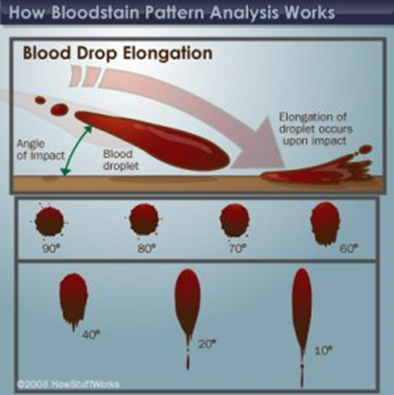
The dynamic of blood stains
Depending on the shape, it is possible to judge the angle and the rate of blood traces

Slide 39
Blood pattern

Slide 40
Blood pattern

Slide 41
Analysis of blood stains
https://www.youtube.com/watch?v=3jFKZaSeNjg

Slide 42
Video about blood stains
https://slideplayer.com/slide/9366431/

Slide 43
Secondary crime scene analysis
The secondary analysis of the crime scene is extensive
Includes autopsy, laboratory tests, ballistics, DNA analysis, veterinary toxicology, entomology and much more
https://www.news-medical.net/

Slide 44
Determination of animal species according to blood smears
Blood and blood spattern, Shona Johnston

Slide 45
DNA Analysis
Forensic analysis of animal DNA
For the purposes of molecular-genetic research, almost all kinds of biological traces found in forensic practice can be used.
It is important that nuclei of cells containing DNA molecules appear in these traces.
If the assured biological traces do not contain nuclei, molecular-genetic investigation cannot be performed.
The most commonly used biological traces include blood, saliva, ejaculate, hair and hair with roots, bones, tissue fragments, peeled skin particles, and more.

Slide 46
DNA analysis
Analysis of animal DNA consists of the following steps:
Sampling for analysis
DNA isolation
DNA purification
Quantification of DNA
DNA amplification by PCR techniques
Electrophoresis
Sequence analysis
Interpretation of forensic genetic data
Database analysis
Zdroj:https://www.timesofisrael.com/

Slide 47
Veterinary toxicology
Veterinary toxicology is a discipline dealing with the determination of chemicals, toxins and poisons that can penetrate the animal body.
Not all poisonings are intentional, some are after accidental exposure to poison, the forensic investigator must be able to recognize accidental intoxication from intentional poisoning.
Examination of the animal and investigation at the scene will indicate what intoxication is suspected.
When investigating, emphasize personal safety, use protective equipment whenever poisoning is suspected
Toxicology and pharmacology are the basis for understanding how xenobiotics (poisons, toxins and drugs) can enter, distribute and excrete from the body.
Poisons are substances derived from chemicals or or produced synthetically from natural substances.
Toxins are biologically derived substances and can occur in nature.

Slide 48
Veterinary toxicology
Clinical symptoms present in the patient are essential guidelines for determining or eliminating possible causes of animal poisoning.
Understanding the symptoms and preliminary exclusion or suspicion of a particular toxin / poison / drug will allow subsequent specific analysis of the sample (evidence).
Scientists, veterinarians and toxicologists are qualified to assess physiological, pathological, laboratory and histopathological evidence from victims of poisoning.
Toxicological examination may be a part of the investigation of criminal, civil and insurance proceedings.
These may include assessments of competition between animal races, accidental or unauthorized use of drugs in animals, deliberate poisoning in animal competitions, inadvertent ingestion of poisonous plants, agro terrorist activities, and more.

Slide 49
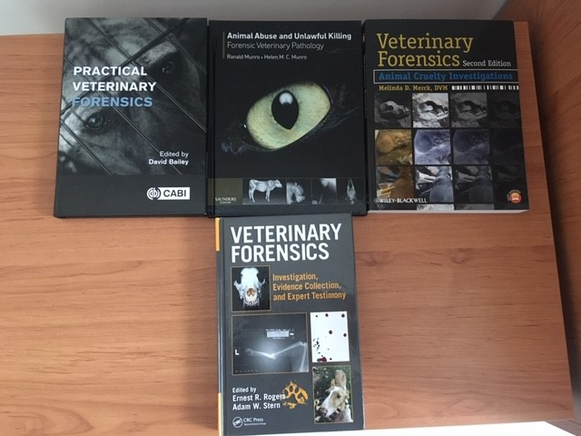
Sources:

